Slide 1
Rigor and Transparency
CTMC
July 7, 2020
Laurie Gutmann, Dietrich Haubenberger, Will Meurer

Slide 2
Input into Chat Box
Please write your name, your institution, your area of research

Slide 3
Input into Chat Box
Please list an aspect of scientific rigor in your area research that you would like to have discussed today.

Slide 4
In Your Grant Application
Rigor of the Prior Research
Rigorous experimental design for robust and unbiased results
Consideration of relevant biological variables
Authentication of key biological and/or chemical resources

Slide 5
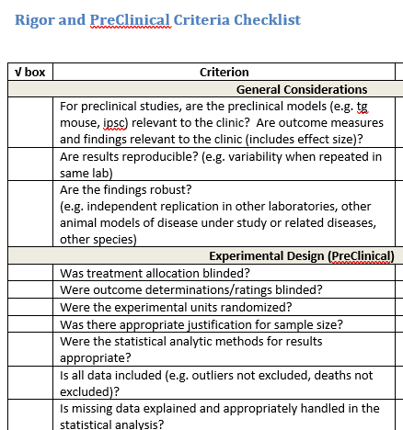
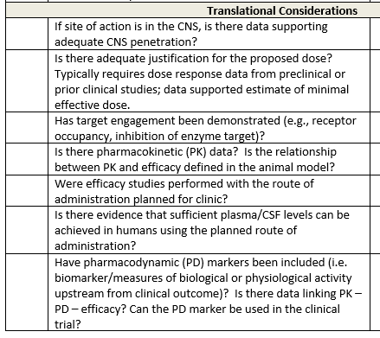

Slide 6
Rigor:
Experimental design:
Rationale for the selected models and endpoints (animal and/or cellular)
Adequacy of the controls
Route & timing of intervention delivery / dosing
Justification of sample size, including power calculation
Statistical methods used in analysis and interpretation of results
Minimizing bias:
Methods of blinding (allocation concealment and blinded assessment of outcome)
Strategies for randomization and/or stratification
Reporting of data missing due to attrition or exclusion
Reporting of all results (negative and positive)
Results:
Independent validation/replication, if available
Robustness and reproducibility of the observed results
Dose-response results
Verification that interventional drug or biologic reached and engaged the target
Interpretation of results:
Alternative interpretations of the experimental data
Relevant literature in support or in disagreement with the results
Discussion of effect size in relation to potential clinical impact
Potential conflicts of interest”
http://www.ninds.nih.gov/funding/transparency_in_reporting_guidance.pdf
https://www.ninds.nih.gov/Current-Research/Trans-Agency-Activities/Rigor-Transparency/RigorChampionsAndResources

