Slide 1
Good Clinical Practices
Marianne Kearney Chase
Director of Research Operations
Neurological Clinical Research Institute (NCRI)
Massachusetts General Hospital (MGH)
Dixie Ecklund, RN, MSN, MBA, CCRC
Director of Operations
Clinical Trials Statistical & Data Management Center
University of Iowa
September 10, 2018

Slide 2
Good Clinical Practices
ICH E6
IRBs (3)
Investigator (4)
Sponsor (5)
Protocol (6)
IB (7)
Essential docs (8)
FDA 21 CFR
Electronic docs (11)
Informed Consent (50)
$ disclosure (54)
IRBs (56)
IND regs (312)
GCPs
HHS 45 CRF 46
IRBs (Subpart A)
Informed consent (A)
Women (B)
Prisoners (C)
Children (D)

Slide 3
Why regulate clinical trials?
To ensure the rights, safety, and well-being of human subjects participating in research
To provide useful scientific data to improve or change the standard of care

Slide 4
Good Clinical Practices
A standard for the design, conduct, performance, monitoring, auditing, recording, analysis and reporting of clinical trials that provide assurance that the data and reported results are credible, accurate and that the rights, integrity and confidentiality of trial subjects are protected

Slide 5
International Conference on Harmonization (ICH) Guidelines
Goal of the ICH is to harmonize the requirements to obtain drug approval in US, Europe and Japan
Typically referring to Section E6 – Good Clinical Practices, first published in 1996
Recent Revision - ICH GCP E6 R2 – Step 4 – November 2016

Slide 6
Recent Revision to ICH GCP Guidance ICH GCP E6 R2 – Step 4 – November 2016
Amended to encourage implementation of improved and more efficient approaches to clinical trial design, conduct, oversight, recording, and reporting while continuing to ensure human subject protection and reliability of trial results
Supplements existing guidance with additional text to provide more details on individual topics
Risk-based monitoring
Data integrity
Quality management

Slide 7
ICH GCP Guideline – 8 sections
Glossary of Terms
Principles of GCP
Requirements for IRB/EC
Requirements for Investigators
Requirements for Sponsors
Requirements for clinical trial protocol and protocol amendments
Responsibilities of a Sponsors to develop an Investigator’s Brochure
Essential Documents

Slide 8
Definitions
Sponsor: An individual, company, institution, or organization which takes responsibility for the initiation, management, and/or financing of a clinical trial
Focus on overall study objectives
Responsibility of reporting to FDA and IRB
Investigator: A person responsible for the conduct of the clinical trial at a trial site
Focus on subjects and implementation of study protocol
Responsibility of Investigative site with reporting to IRB and Sponsor

Slide 9
Sponsor- Investigator
An individual who both initiates and conducts, alone or with others, a clinical trial, and under whose immediate direction the investigational product is administered to, dispensed to, or used by a subject. The term does not include any person other than an individual (e.g., it does not include a corporation or an agency). The obligations of a sponsor-investigator include both those of a sponsor and those of an investigator.
Wearing both “hats” can be challenging

Slide 10
Academic Trial Sponsors
Regulatory “sponsor” – person who submits IND application to FDA
Financial “sponsor” – funding source (NIH, industry collaborator, foundation, etc)
Coordinating Center – team that assists academic PI to fulfill all regulatory requirements of managing clinical study

Slide 11
When do ICH Guidelines Apply?
Studies conducted in the US which are intended to be marketed in ICH regions
Studies conducted in ICH regions which intend to submit results to the FDA for approval in the US

Slide 12
Many Trials are Conducted Globally…

Slide 13
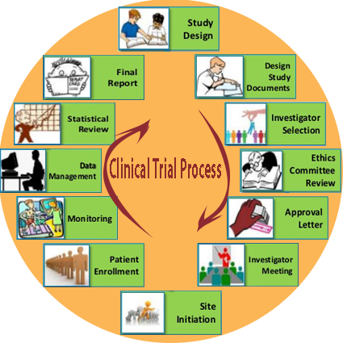

Slide 14
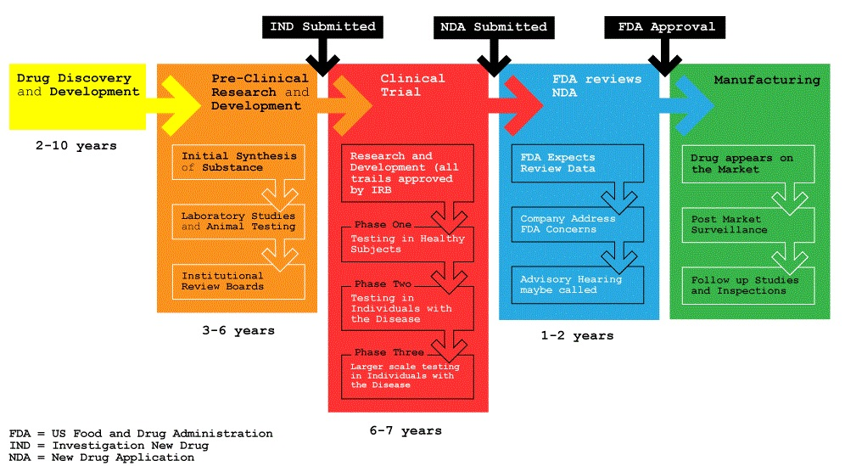

Slide 15
Quality & Delegating Tasks
Quality Assurance and Quality Control
Implement and maintain QA and QC systems with written SOPs
**Use risk-based approach to quality management systems**
CRO
Any trial-related duties and functions transferred to a CRO should be specified in writing
**Oversee trial-related duties subcontracted to a CRO**
Medical Expertise
Designate appropriately qualified medical personnel to advise on trial related medical questions or problems

Slide 16
Trial Design & Management
Trial Design
Utilize qualified individuals for all stages of trial process (design, CRF design, data analysis, study reports, etc)
Trial Management, Data Handling, Record Keeping, and Independent Data Monitoring Committee
Utilize qualified individuals to handle, verify and conduct analysis of data
When using electronic data handling, ensure EDC is validated, secure, permits changes, maintain SOPs for system, maintain audit, data and edit trails
**When using computerized systems, base validation approach on a risk assessment, maintain SOPs and ensure data integrity**
Notes:
Sponsor Responsibilities
Trial Design
Utilize qualified individuals for all stages of trial process (design, CRF design, data analysis, study reports, etc)
Trial Management, Data Handling, Record Keeping, and Independent Data Monitoring Committee
Utilize qualified individuals to handle, verify and conduct analysis of data
When using electronic data handling, ensure EDC is validated, secure, permits changes, maintain SOPs for system, maintain audit, data and edit trails

Slide 17
Site Selection and Contracting
Investigator Selection
Select trained and qualified
investigators/ institutions
Compensation of Subjects and Investigators
Provide insurance of indemnification to investigator /institution
Establish policies and procedures addressing costs of treatment of subjects in event of trial-related injury

Slide 18
Regulatory Submissions
Regulatory submissions:
Submit required applications prior to initiation of a study (FDA)
Confirmation of Review by IRB
Obtain IRB name, address and assurance number
Obtain IRB approval letters for all submissions (initial protocol, amendments, continuing review, etc)

Slide 19
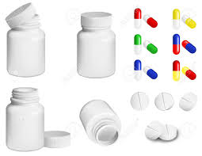
Investigational Product (IP)
Information on the IP
Update Investigator’s Brochure (IB) as significant new information becomes available
Manufacturing, Supply and Handling IP
Collect and maintain documentation of GMP manufacturing
Supply to sites only after all regulatory documents collected
If blinded study, create systems that ensure study blind
Ensure timely delivery and re-supply

Slide 20
Safety
Safety Information
Responsible for ongoing safety evaluations
Promptly notify investigator/institution, and appropriate regulatory authorities of findings that could adversely affect subject safety
Adverse Drug Reaction Reporting
Expedite reporting of all adverse drug reactions (ADRs) that are both serious and unexpected
Submit safety updates and periodic reports per applicable regulatory requirements

Slide 21
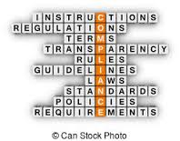
Monitoring
Monitoring
Ensure that trial data are accurate, complete and verifiable
Ensure trial conducted in compliance with protocol, GCP and other applicable regulatory requirements
**Develop a systematic, prioritized, risk-based approach**
**Develop a monitoring plan tailored to the human subject protection and data integrity risks of the trial**
**May use varied approaches to monitoring (on-site, centralized) to improve effectiveness and efficiency**
**Document the rationale for the monitoring strategy**
**Document results of monitoring activities**

Slide 22
Non-Compliance/ Audits
Noncompliance
Act quickly in situations of noncompliance
Terminate investigator’s participation in cases of persistent noncompliance
**Follow up of non-compliance that has or may significantly affect human subject protection or reliability of trial results, by performing a root cause analysis and implementing preventative actions**

Slide 23
Suspension / Termination and Reporting Requirements
Premature Termination or Suspension of Trial
If required, promptly inform the investigators/institutions, and regulatory authorities and describe reasons
Provide instruction to sites to notify their local IRB of the action
Clinical Trial/Study Reports
Prepare reports and provide to appropriate regulatory authorities

Slide 24
Multicenter Trials
Multicenter Trial
Ensure all investigators conduct trial in strict compliance with the protocol approved by Sponsor, regulatory authorities and IRB
CRFs are designed to capture the required data at all multicenter trial sites.
The responsibilities of the coordinating investigator(s) and other participating investigators are documented prior to the start of the trial
All investigators are given instructions on following the protocol, complying with a uniform set of standards for assessments and completing CRFs
Communication between investigators is facilitated

Slide 25
Investigator Obligations

Slide 26
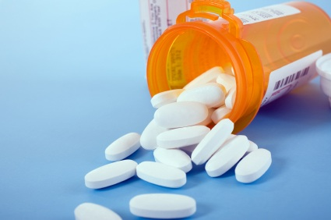
Responsibilities
Site Investigator Responsibilities (21CFR 312.60)
Protect the Rights, Safety, and Welfare of study subjects
Ensure that the investigation is conducted according to the approved protocol and applicable regulations (Federal, State, Local)
Control drugs, biologics, and devices under investigation (312.61)
Most but not all of these requirements are listed in FDA-1572 Form
Notes:
Sec. 312.61 Control of the investigational drug. An investigator shall administer the drug only to subjects under the investigator's personal supervision or under the supervision of a subinvestigator responsible to the investigator. The investigator shall not supply the investigational drug to any person not authorized under this part to receive it.

Slide 27
FDA 1572 Form

Slide 29
FDA Guidance Protecting the Rights, Safety, and Welfare of Study Subjects
Provide reasonable medical care for study subjects for medical problems that are, or could be, related to study intervention
Provide reasonable access to medical care
The investigator should be available 24/7 to subjects during the conduct of the trial
Adhere to the protocol so that subjects are not exposed to unreasonable risks, examples:
Failure to adhere to I/E Criteria: enrolling subject with renal failure in trial excluding people with renal failure because the investigational drug may be nephrotoxic
Omitting a safety measure: CBC for a therapy that causes neutropenia
Site investigator should inform the subject’s primary physician about the subject’s participation in the trial, if the subject agrees

Slide 30
Delegation – FDA Guidance Tasks can be delegated but not responsibility!
When tasked are delegated, the investigator is responsible for
Choosing qualified individuals to perform delegated tasks
Providing adequate training for the delegated tasks and for study protocol
Providing adequate supervision and oversight
All should be clearly outlined in the delegation log
Commonly inappropriately delegated tasks identified by FDA inspections
Screening evaluations (medical history, assessment of I/E criteria)
Physical exams
Evaluation of AE’s
Assessments of primary study endpoints
Obtaining informed consent
‘The investigator is accountable for regulatory violations resulting from failure to adequately supervise the conduct of the clinical study’

Slide 31
Delegation – FDA Guidance Adequate Training
Investigator should ensure that site staff:
Are familiar with the purpose of the study and the protocol
Have an adequate understanding of the specific details of the protocol needed to perform their assign tasks (FVC)
Are aware of the regulatory requirements and acceptable standards for conduct of clinical trials and protection of human subjects (GCP)
Are competent to perform the tasks (ECG, VS, FVC)
Are informed of any pertinent protocol changes

Slide 32
Delegation – FDA Guidance Adequate Supervision (1)
Site Investigator should have sufficient time to properly conduct and supervise the clinical trial
FDA identified factors that may affect the ability
of an investigator to provide adequate supervision
Inexperience study staff
Demanding workload for study staff
Complex clinical trials
Large number of subjects enrolled at the site
Seriously ill subject population
Conducting multiple studies concurrently at the site
Conducting a study from a remote (e.g., off-site) location

Slide 33
Delegation – FDA Guidance Adequate Supervision (2)
Site Investigator should develop a supervision plan
Routine meetings with study staff (trial progress, protocol updates, AE’s, etc.)
Documenting the performance of delegated tasks (delegation log – CV, Training)
A procedure for ensuring proper consenting (consenting check list, note)
A procedure for ensuring that source data are accurate, updated & original (review)
A procedure for ensuring accurate match between source docs and CRFs (review)
Meetings with Study Monitor and a procedure for dealing with queries (check list)
A procedure for addressing medical and ethical issues that arise during the trial (keep Sponsor, IRB and MM informed)

Slide 34
You are Responsible

Slide 35
Site selection
Pre-selection site questionnaire
Number of patients in clinic
Number of patients that may fulfill the I/E criteria
IRB process and timelines
Contracts process and timelines
Site PI and CRC/RN experience
Important Factors
Accurate information
Reasonable estimates
Respond quickly!

Slide 36
Site Activation Checklist
Contract: Fully executed Clinical Trial Agreement (CTA) (3+ months)
IRB approval letter of current protocol and ICF (4+ months)
Investigator’s signature on protocol and IB
Signed and dated FDA 1572
Financial disclosures for all study staff on 1572
IRB membership list
Human Subject Protection Training Certification (CITI)
Training: Protocol, Outcome measures, and EDC trainings
Investigators Meeting
Site Initiation Visit
Atassi N et al. Neurology 2013

Slide 37
Enrollment
Recruitment tools (IRB approved)
Letters
Website
Patient database
Consenting
Information – Comprehension – Volunteering
Why are we conducting the trial?
What happens in this trial?
What are the Risks? And what’s the Risk:Benefit Ratio?
Who is conducting this research? and who to contact?
Ongoing process
ICF: signatures, date, time, copies
Screening and Randomization
Eligibility check list, signed by PI
Randomization note signed by PI

Slide 38
Follow up Visits
Guidance: Protocol, IB, and Study Monitor
Visits (SOA)
Within window
Complete assessments
Safety first (labs, AEs, SAEs, PDs)
Source and CRF’s clear and clean
Document Document Document
‘Not Documented = Never Happened’
Data entry up-to-date
Monitoring visits (prepare, meet, address, follow up)
Keep your grant manager in the loop

Slide 39
Safety First (1) 21CFR 312.32
Adverse Events (AE)
Any untoward medical occurrence associated with the use of a drug in humans, whether or not considered drug related.
Always ask subjects
Volunteered, prompted, Lab, Physical Exam
Coding (MedRA vs. CTCAE)
Date and time of onset and resolution
Severity?
Relatedness to study drug(s) or trial procedures
Expectedness, as listed in the IB at the observed specificity or severity
Notes:
Common Terminology Criteria for Adverse Events (CTCAE)
Medical Dictionary for Regulatory Activities (MedRA)
"Unexpected," as used in this definition, also refers to adverse events or suspected adverse reactions that are mentioned in the investigator brochure as occurring with a class of drugs or as anticipated from the pharmacological properties of the drug, but are not specifically mentioned as occurring with the particular drug under investigation.

Slide 40
Safety First (2) 21CFR 312.32
Serious Adverse Event (SAE)
Criteria (in view of investigator or sponsor)
Death
Life Threatening (immediate risk of death)
Hospitalization or prolong existing hospitalization
Persistent or significant inability to conduct normal life functions
Congenital anomaly or birth defects
Important Medical Events: Require an intervention to prevent the above (ER treatment of allergic reaction, long-term disability, etc.)
Reporting to sponsor (within 24h)
Reporting to Site IRB (Per Site IRB rules)
Follow up

Slide 41
Safety First (3) 21CFR 312.32
Labs
Clinical significance
Reporting as AE
Follow up!
Protocol Deviations
?affect subject safety
Missed/delayed safety assessment
Missed I/E criterion
Con meds (interaction with Investigational Product)
?affect trial integrity
I/E, outcome, Disallowed/Investigational meds, Drug accountability, etc.
Keep a Log of PD’s

Slide 42
Site Close Out
All subjects at site completed final study visit
Source and CRF match and complete
PI Sign off on CRF’s or e-CRF’s (EDC)
Queries answered
Close out visit

Slide 44
Record Keeping and Retention 21CFR 312.62
Adequate Records for Disposition of Drug
Dates, quantity, and use by subject
Fate of unused drug (returned to sponsor, destroyed at site)
Case Histories
Case Report Forms (CRF’s)
Supporting forms: ICF, Medical Records, etc
Regulatory binder
Record Retention for 2 years after
NDA is approved for the same investigated indication
Investigation is discontinued and FDA is notified (No NDA)

Slide 45
Take Home Messages
Site investigator takes the overall responsibility of the rights, safety, and welfare of study subjects
Tasks can be delegated to qualifies individuals with appropriate supervision
Responsibility cannot be delegated
If not documented, it never happened
Safety First
Always maintain good communication with site staff, IRB, study monitor, and trial sponsor

Slide 46
What happens when an investigator does not follow these guidelines and regulations?
Human subjects are placed in jeopardy or harm or are harmed
Public gains distrust of clinical research
Investigator restrictions or debarment
Institutions lose FWA, lose federally funded research
FDA Audits
Form 483 - warning

Slide 47
Questions?

