Slide 1
Quality Data Management in Clinical Trials
Catherine Dillon, MS
Wenle Zhao, PhD
Department of Pubic Health Sciences
Medical University of South Carolina, Charleston, SC
4th Annual Innovations in Clinical Data Management, Arlington, VA.
October 27-28, 2016
Notes:
Overall, very good, very informative presentation. Most of my comments are embedded in comment bubbles on the relevant slides or sections of slides. The format and animation are great for displaying detailed information in an easy to follow sequence. My only overall comment to reiterate is that this presentation reads like an advanced data quality course/lesson, but I didn't see that much that would be considered innovative in the spirit of this conference. I suggest annotating in the slides or highlighting in the verbal presentation where the methods illustrated are either new and/or innovative and how they will benefit the audience.

Slide 2




Slide 3
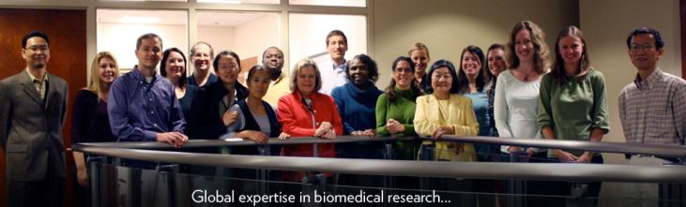



Data Coordination Unit at MUSC

Slide 4
Contents
Clinical trial data quality risk factors
Prevention of data quality problems
Detection of data quality problems

Slide 5
1.
Clinical trial data quality risk factors

Slide 6
There is only one way
of doing things
correctly.
There are many ways
of doing things
wrong.

Slide 7
Trial quality and data quality
GCP
What needs to be done
Statistician
exactly
Study design
Plan what to do
Physician
exactly
Trial operation
Do what is planned
Study Coordinator
exactly
Data management
Record what is done
Data Manager
A successful trial
A failed trial

Slide 8
Causes of failed trials
Treatment effect does exist
Treatment effect does not exist
Signal Dilution
Under power
Bias or Fraud
Positive
Neutral / Negative
Positive result ≠ Successful trial Neutral / Negative result ≠ Failed trial
The goal of a trial is to find out the truth; positive, negative, or neutral.

Slide 9
Design issues of a failed trial
Cannot recruit enough patients ➔
Narrow eligibility criteria for patients,
or complex study procedures for sites.
Science is not there ➔
Insufficient or unreliable data for the hypothesis to be tested.
Too many research aims ➔
Excessive clinical assessment and data collection demands on limited resource.
Unstable study design ➔
Lack of detailed study protocol.
Frequent protocol amendments.
Potential bias and fraud ➔
Randomization method is vulnerable to selection bias and assessment bias.

Slide 10
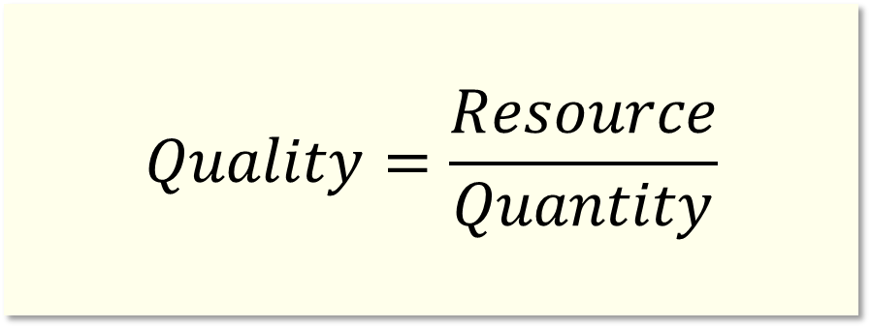
Excessive trial operation procedures
$$Quality=\frac{Resource}{Quantity}$$
With limited resources, more work to be done suggests lower quality to be expected.

Slide 11
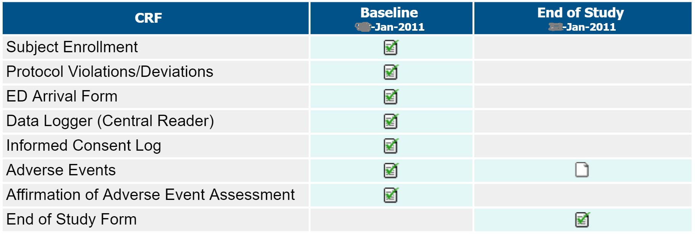
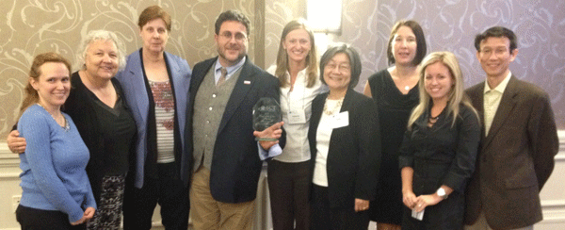
Example 1: RAMPART, a large simple trial
Unique CRFs = 8
Unique Data Items = 178
Study Visits = 2
Visit-CRF Posting = 9
Trial of the Year award, Society for Clinical Trials 2013

Slide 12
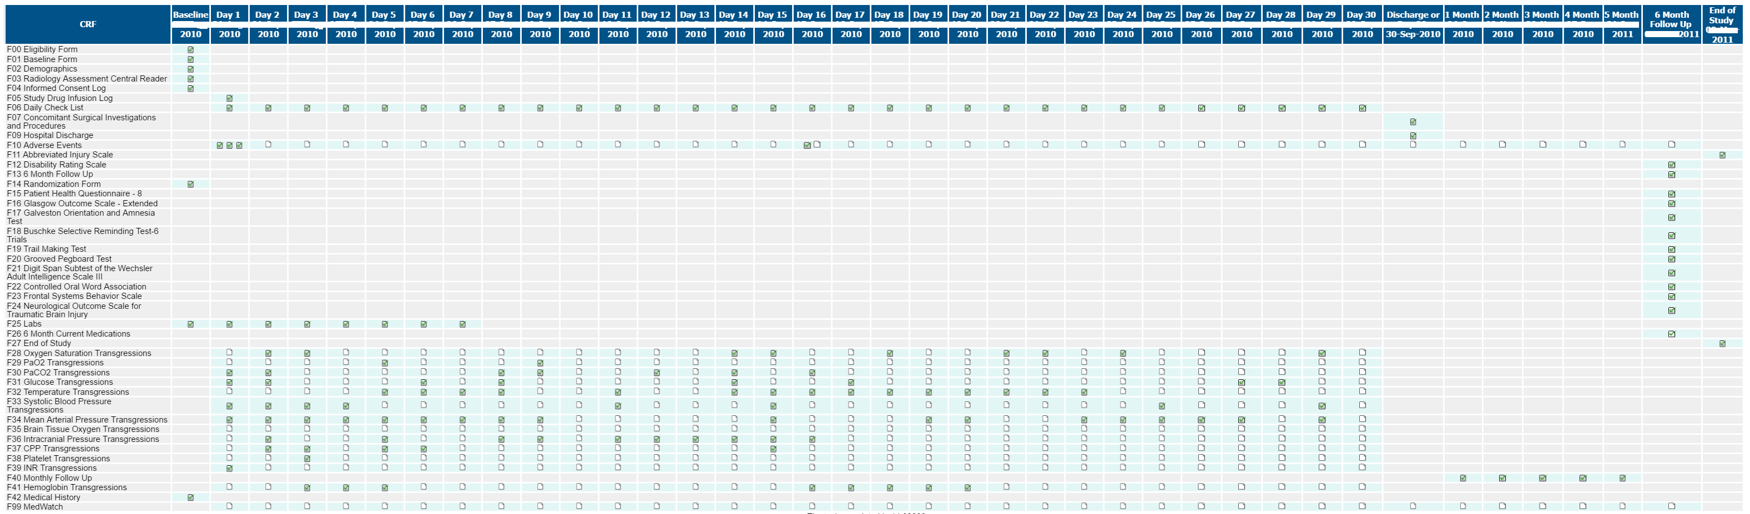
Example 2: ProTECT, a complex trial
Unique CRFs = 44
Unique Data Items = 1278
Study Visits = 10~39
Visit-CRF Posting = 158~535
After 882 subjects enrolled from 38 sites in 4 years, this study was terminated in 2014 due to futility.

Slide 13
Example 3: Investigator assessment bias
Hamilton Rating Scale for Depression (HRSD) assessment
Notes:
CA systematically rated higher at basedline and lower after treatment when comparted to IBA.
On average, abase basleine CA rated 2 poits higher than IBA. After treatment, CA rates 2 poisnt lowere than IBA. This difference is close to the treatment effect we try to detect.
While this slide is showing all subjects, the Impact is that the treatment effect will be diluted between the 2 groups. Dilutes the signal.

Slide 14


Example 4: Suspicious selection bias
The NINDS rt-PA Stroke Study
tPA arm
Placebo arm
$$\text{31 }\text{patients} \text{had} \text{randomization} \text{glitches}\text{, 26 }\text{tPA}\text{, 5 }\text{placebo}\text{. }\text{p}\text{ = 0.000096}$$
$\text{1 }\text{placebo}$ → tPA
21 tPA → placebo p = 0.0000055
$$\text{Selection} \text{bias}\text{?}$$
Sources: Marc Walton, Clinical Review for PLA 96-0350, June 12, 1996.
Vance Berger, Selection Bias and Covariate Imbalances in Randomized Clinical Trials, John Wiley & Sons, Ltd. 2005. Page 74-75.

Slide 15
Operation issues of a failed trial
Missing primary outcome ➔
Enroll patients too healthy ➔
Enroll patients too sick ➔
Treatment cross-over ➔
Having a subject with such error is worse than not enrolling the subject!
To recover the power loss for 1 cross-over, 2 subjects are needed.
Notes:
Missing primary outcome. If you are missing 10% of your outcomes,. 90% juice with 10% water dilutes the treawtment effect.
Everyone who is missing, despite arm, can go to 0 (failure). If everyone is a failure, you don’t see any difference between the groups.
Too healthy, 100% success, no difference between the groups.
All of these dilute the treatment effect.
Applies to both arm.

Slide 16
Operation issues of a failed trial
Treatment
Placebo
Ineligible patient
Treatment
Placebo
Treatment cross-over
Treatment
Placebo
Trial operation errors
Treatment
Placebo
Treatment non-adherence
Outcome assessment errors
Treatment
Placebo
Missing primary outcome
Treatment
Placebo
Unbiased trial operation errors dilute the treatment effect, if it exists.
Notes:
Put together, no difference at all.

Slide 17
Power reduction due to signal dilution
To get the same power under this trial operation quality, we may need a sample size of 2400.
Notes:
You may need to translate the statistics values for the data managers in the audience.
Assuming we are doing a real trial, trying to detect 7% difference between groups. AT .05 significance, we need 1400 n to have a power of 82.74%..
If operations are bad- 3% not sick, 10% non adherence (including LTFU, withdraw, noncompliance). Reduces the difference from 7% to 5.3% bc diluted the effect. Reduced power from 82.74% to 61%. You will need 1000 more patients are needed to reach power of 82.74%
Significant costs to wrong doing.

Slide 18
Summary – Section 1
The quality of a clinical trial starts from the design.
Operation errors dilute the treatment effect.
Data management cannot fix problems caused by trial design issues and operation errors.
Data managers can help to prevent trial design mistakes and operation errors.
Notes:
how can the data manager help with item #4. Is this recommendation covered in this presentation?

Slide 19
2.
Prevention of
data quality problems

Slide 20
“An ounce of prevention is worth a pound of cure.”
― Benjamin Franklin

Slide 21
Three types of data problems in clinical trials
 |  | Operation Procedure
 |  | Not done | Done incorrectly | Done correctly
Data Collection | Not done | Missing data not confirmed | Missing data
 | Done incorrectly | Fake data | Unintentional data error
 |  |  | Fake data
 | Done correctly | Confirmed missing data | Confirmed protocol violation | Well done!
Notes:
Logistical thinkings
What happened. What was collected?
If the mirror is correct- acceptable from DM perspective, despite errors in operation.
3x 3 scenerio showing combinations of operation and data collection errors.
First thing- prevent missing data.
Second thing- prevent unintentional error
3rd thing- prevent fraud

Slide 22
Action #1: prevent missing data
Study visit: Ensure that required study visits cannot be skipped in the study visit transition matrix.
CRF: Ensure that required CRFs are completed in data collection schedule for each study visit.
Data item: Ensure that required data questions are answered before CRF submission.
Provide the options for confirmation of missing data.

Slide 23
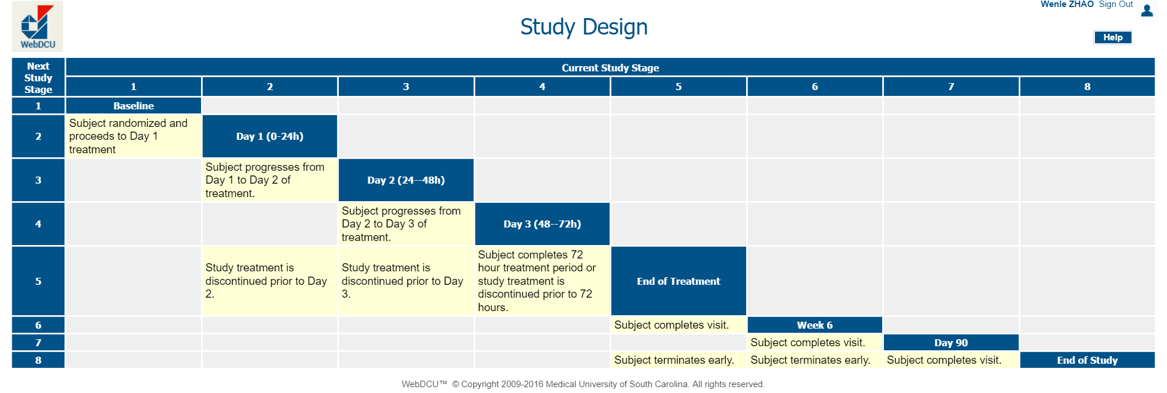
Example 5: Prevent missing study visits
Each subject starts from [Baseline] visit and ends at [End of study] visit.
Transition condition from one visit to another visit must be clearly defined.
Notes:
Suggest zooming in as much as possible to relevant details.

Slide 24
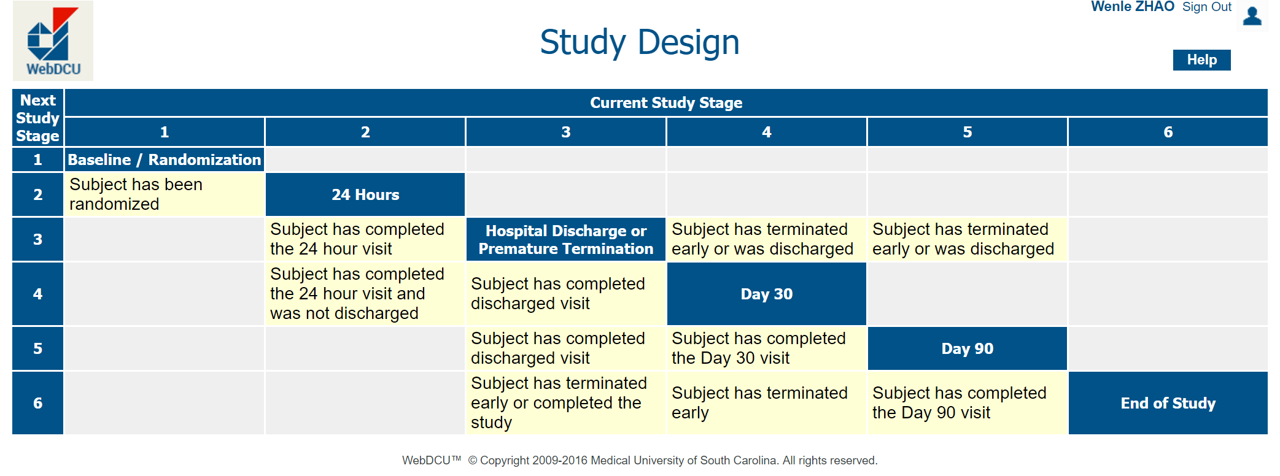
Example 6: Prevent missing study visits
Transition logic must cover all possible scenarios, including protocol permitted skipped visits.

Slide 25
Digitalization of study visit transition logic
Computerized logic enforces protocol compliance and data completeness.

Slide 26
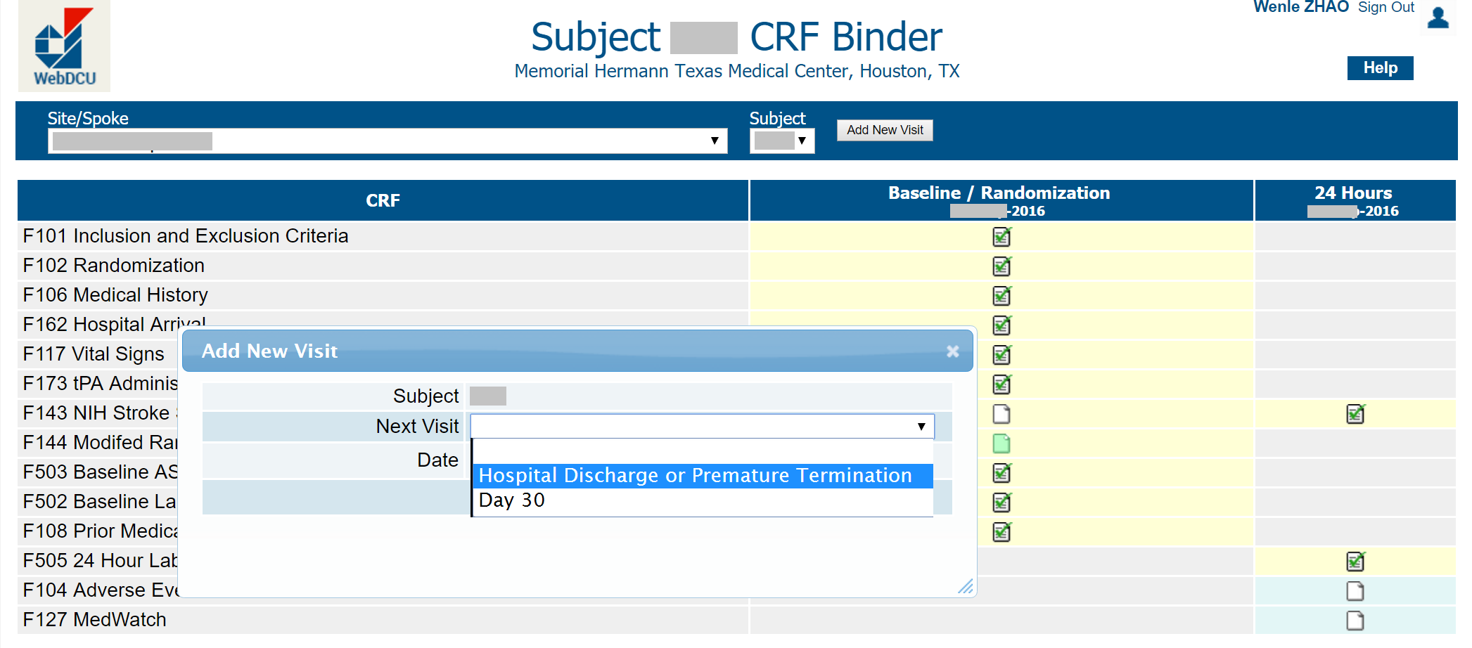
Enforcement of study visit transition logic
Only visits that meet the transition logic are available for selection.
Prevent missed study visit.
Promote immediate data entry.

Slide 27
Prevent missing CRFs
To protect the data integrity:
All subject related study data are collected on Case Report Forms.
CRF collection schedule is defined by study visits.
CRFs are posted for the subject only when the subject visit is registered.
Define CRF requirements:
  Unconditional required
  Conditional required
  Optional
Prevents duplicate, missing, and mismatched CRFs.

Slide 28
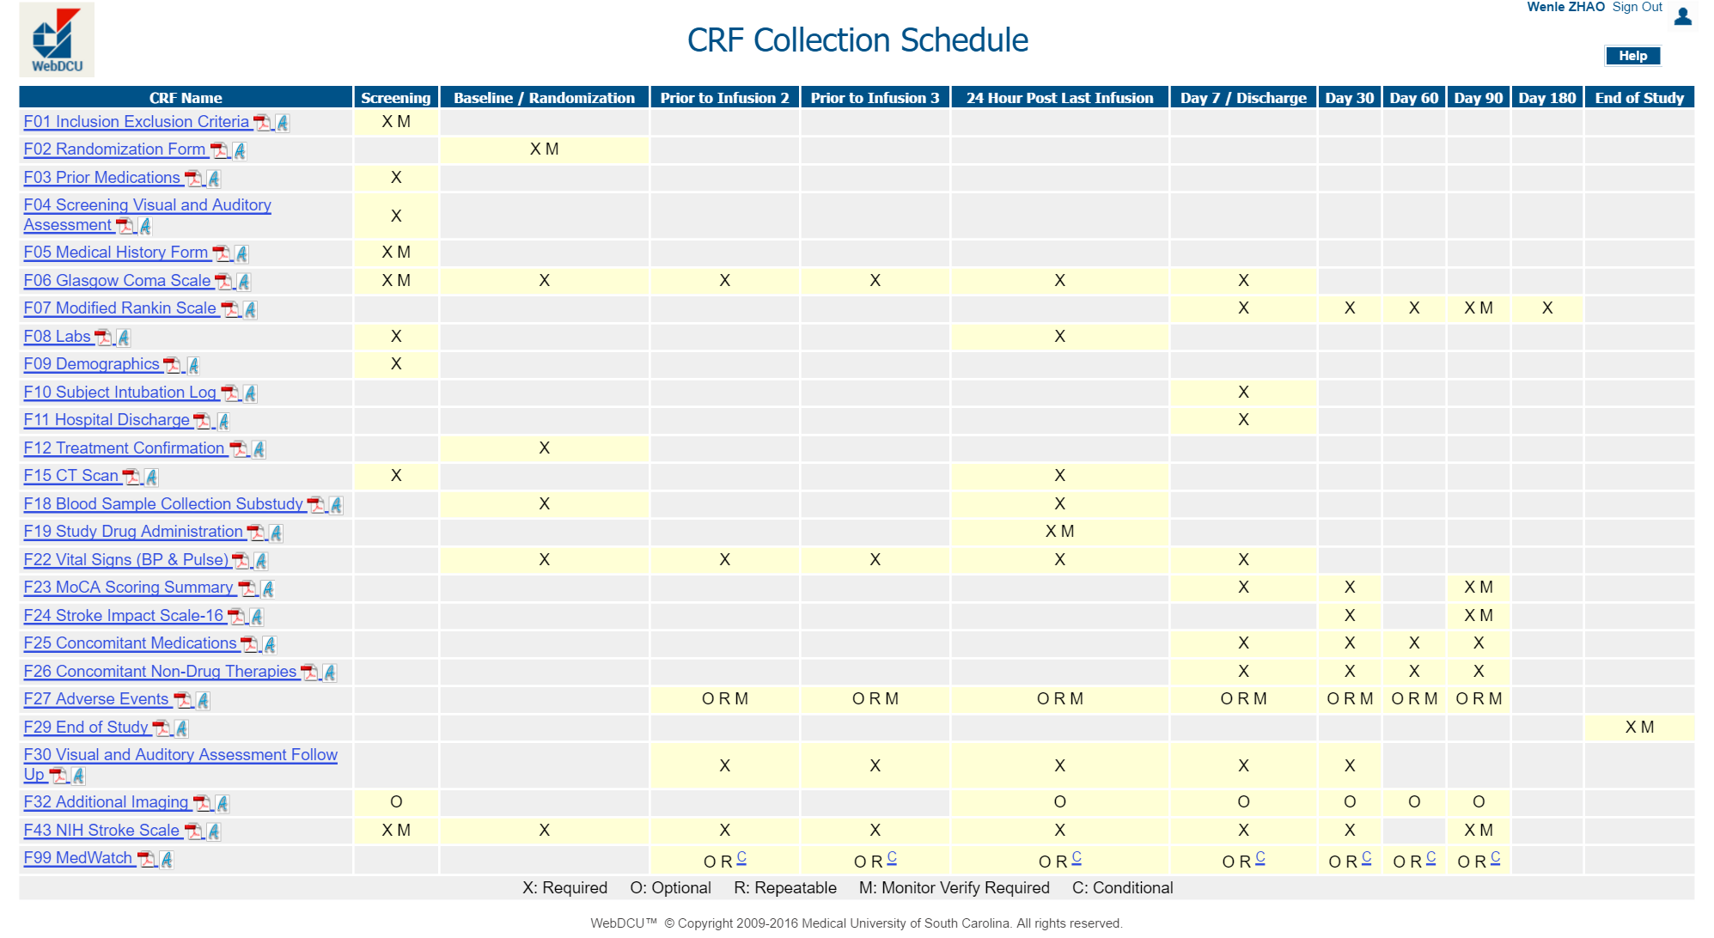
Example 7: CRF collection schedule
Well defined data collection schedule protects data integrity.

Slide 29
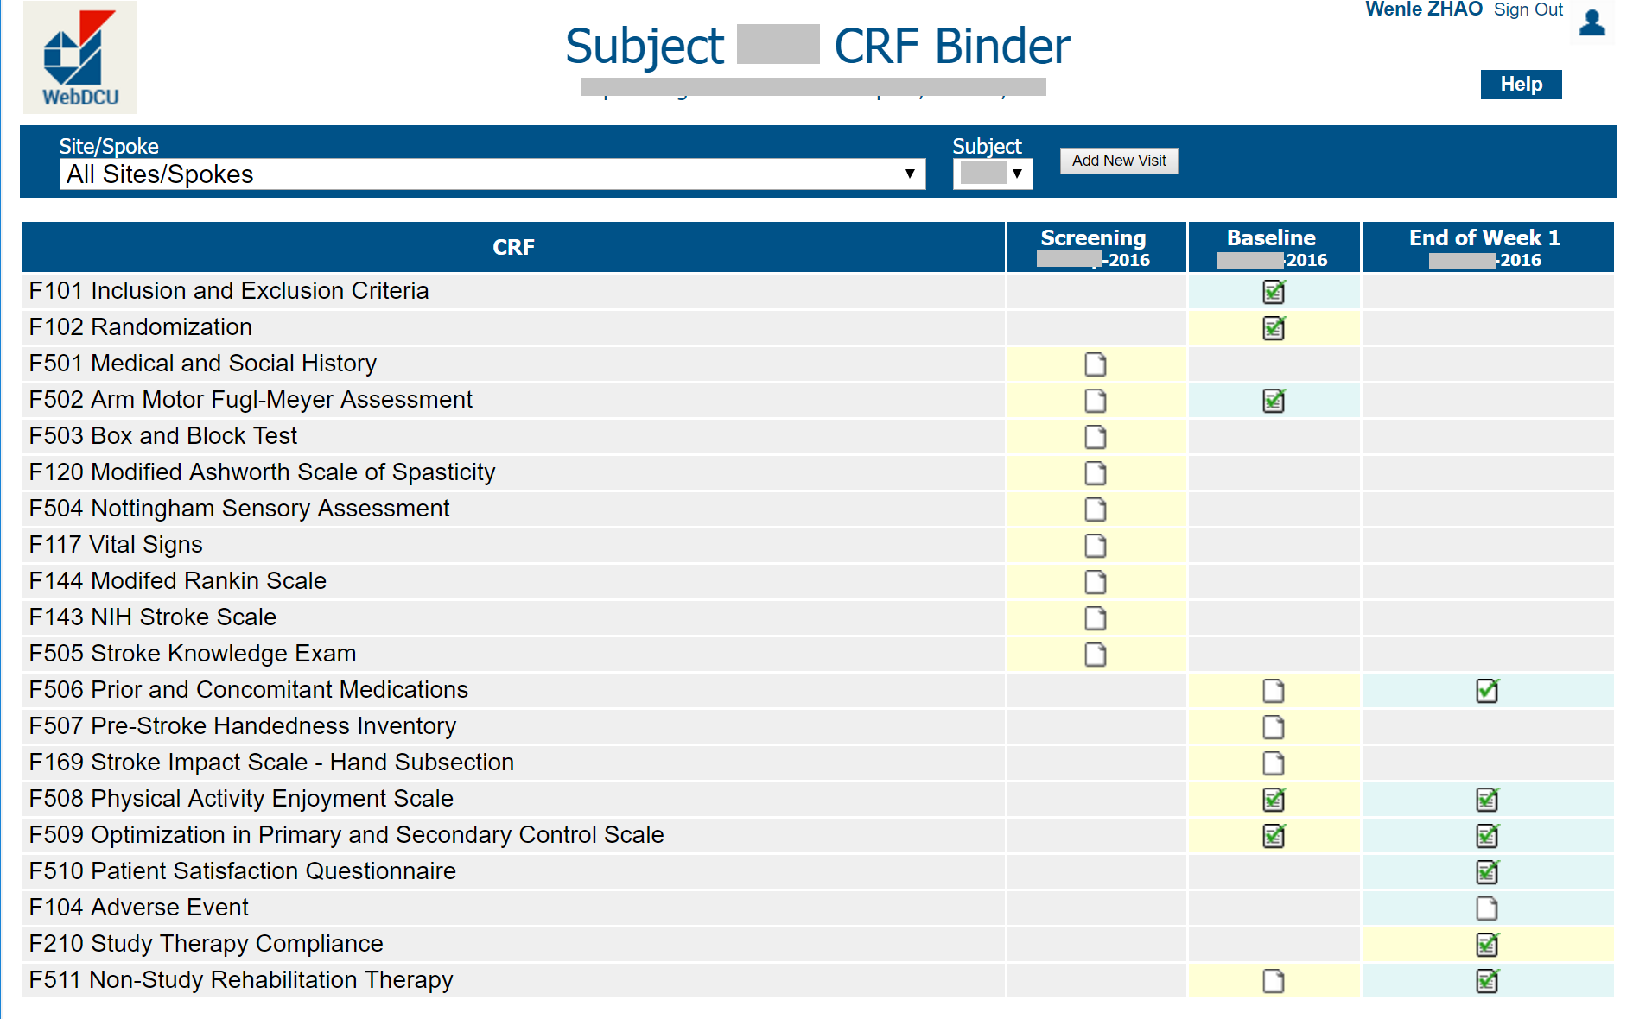
Example 8: Flag missing CRF
All missing CRFs are clearly flagged on the data collection schedule for each subject.

Slide 30
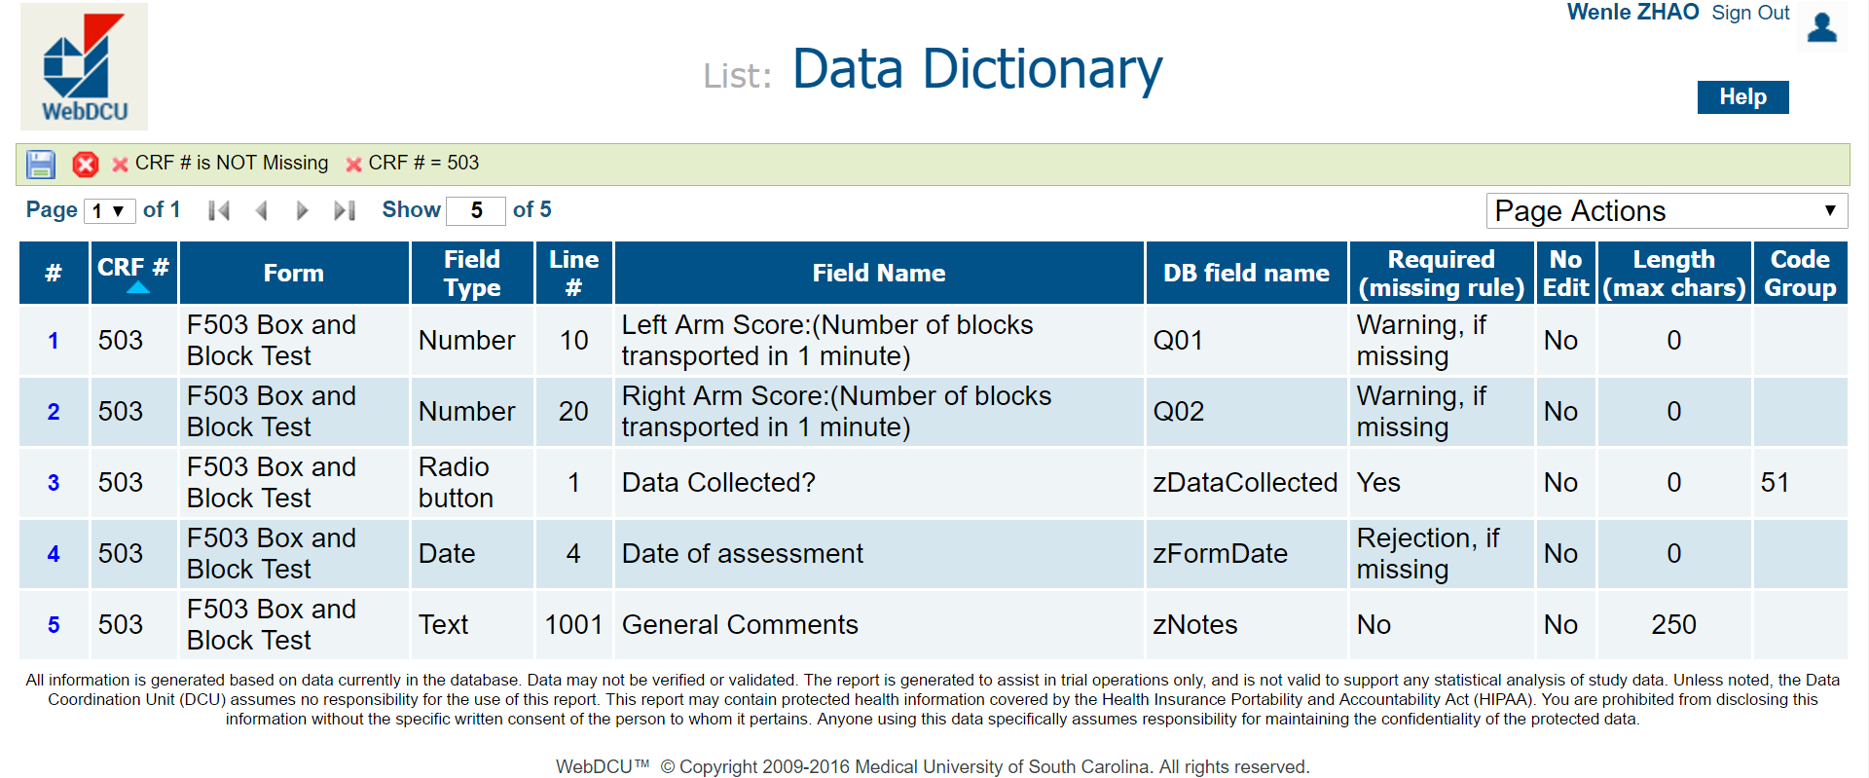
Example 9: Prevent missing data items
Yes: Data is required for CRF record saving.
Rejection, if missing: Data is required for CRF submission.
Warning, if missing: CRF can be submitted with explanation for missing data.
No: Data is optional.

Slide 31
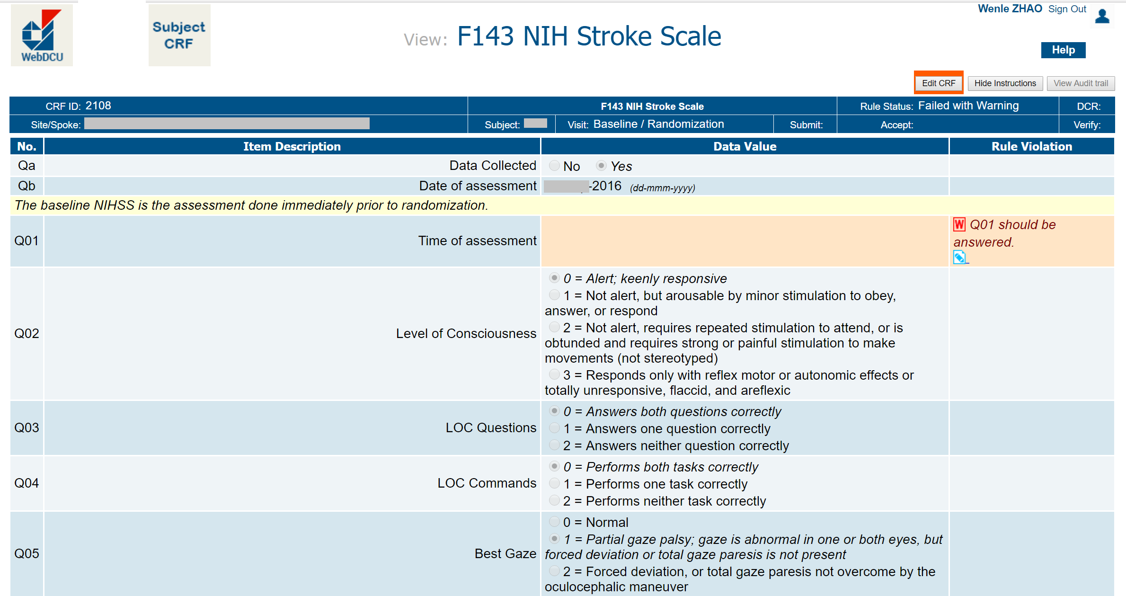
Example 10: Flag missing data items
Missing data item is flagged.

Slide 32
Action #2: prevent data with unintentional error
Make data questions clear and easy to answer.
Create multiple choice questions with sound logic.
Use skip pattern control to reduce data error.
Use real-time rule-based data validation to prevent typos.
Use standardized CRFs to avoid design errors and revisions.
Control protocol amendments and CRF changes.
Maximize computer potential and minimize site work load.

Slide 33
Ask simple questions
    Q01: Baseline blood glucose < 50mg/dL or > 400mg/dL? Yes / No
    Q01: Baseline blood glucose is ________ (mg/dl)
    Q02: How long since your last dentist visit? ______ (days)
    Q02: Date of your last dentist visit: _ _/ _ _ / _ _ _ _ (mm/dd/yyyy)
Q03: Did the patient have chickenpox or measles in the past 12 months and ear infection in the past 6 month? Yes / No
Q03: Did the patient had chickenpox in the past 12 months? Yes/No
Q04: Did the patient had measles in the past 12 months? Yes/No
Q05: Did the patient had ear infection in the past 6 months? Yes/No

Slide 34


Make multiple choice question with sound logic
    Q07: What color it is?
    О Red
    О Yellow
    О Black
    О Red
    О Salmon
    О Fire Brick
    О Dark Orange
    О Coral
    О Tomato
    О Orange Red
    О Chocolate
    О Saddle Brown
    О Wheat
    О Gold
    О Tan

Slide 35


Avoid excessive list of options
    Q01: Primary reason for screen failure is:
Replace long list of radio button options with free text.
Have a central investigator do the grouping afterwards.
Notes:
Mark Taylor 10/21/2016
This may not be conventional wisdom, spend time explaining this to audience.

Slide 36
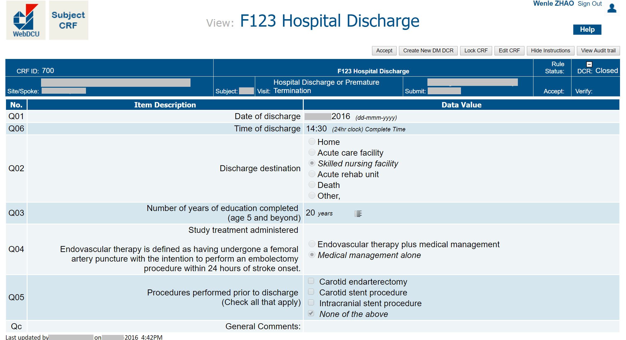
Example 11: Consider all possible responses
Other covers all that are not expected.
Unchecked checkbox = No, not Null.
    Including “Other” in Q02 to cover all not listed.
    Including “None of the above” in Q05 to positively confirm the response.

Slide 37
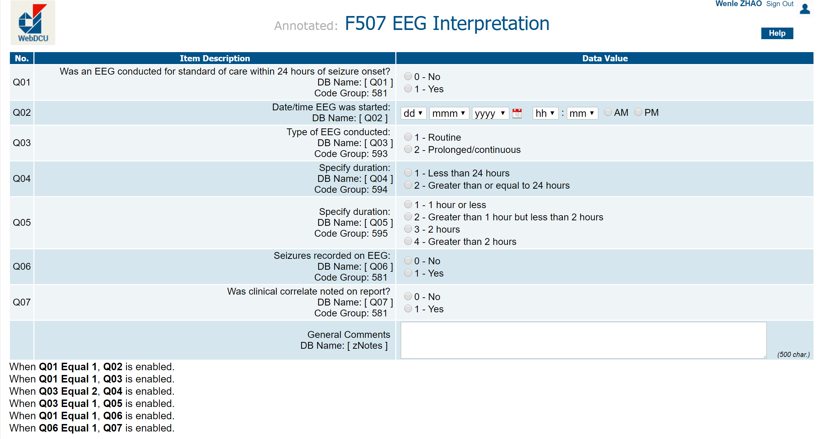
Example 12: Use skip pattern controls
    Define skip pattern controls to avoid basic logic conflicts.
    Enforce skip patterns in EDC user interfaces.

Slide 38
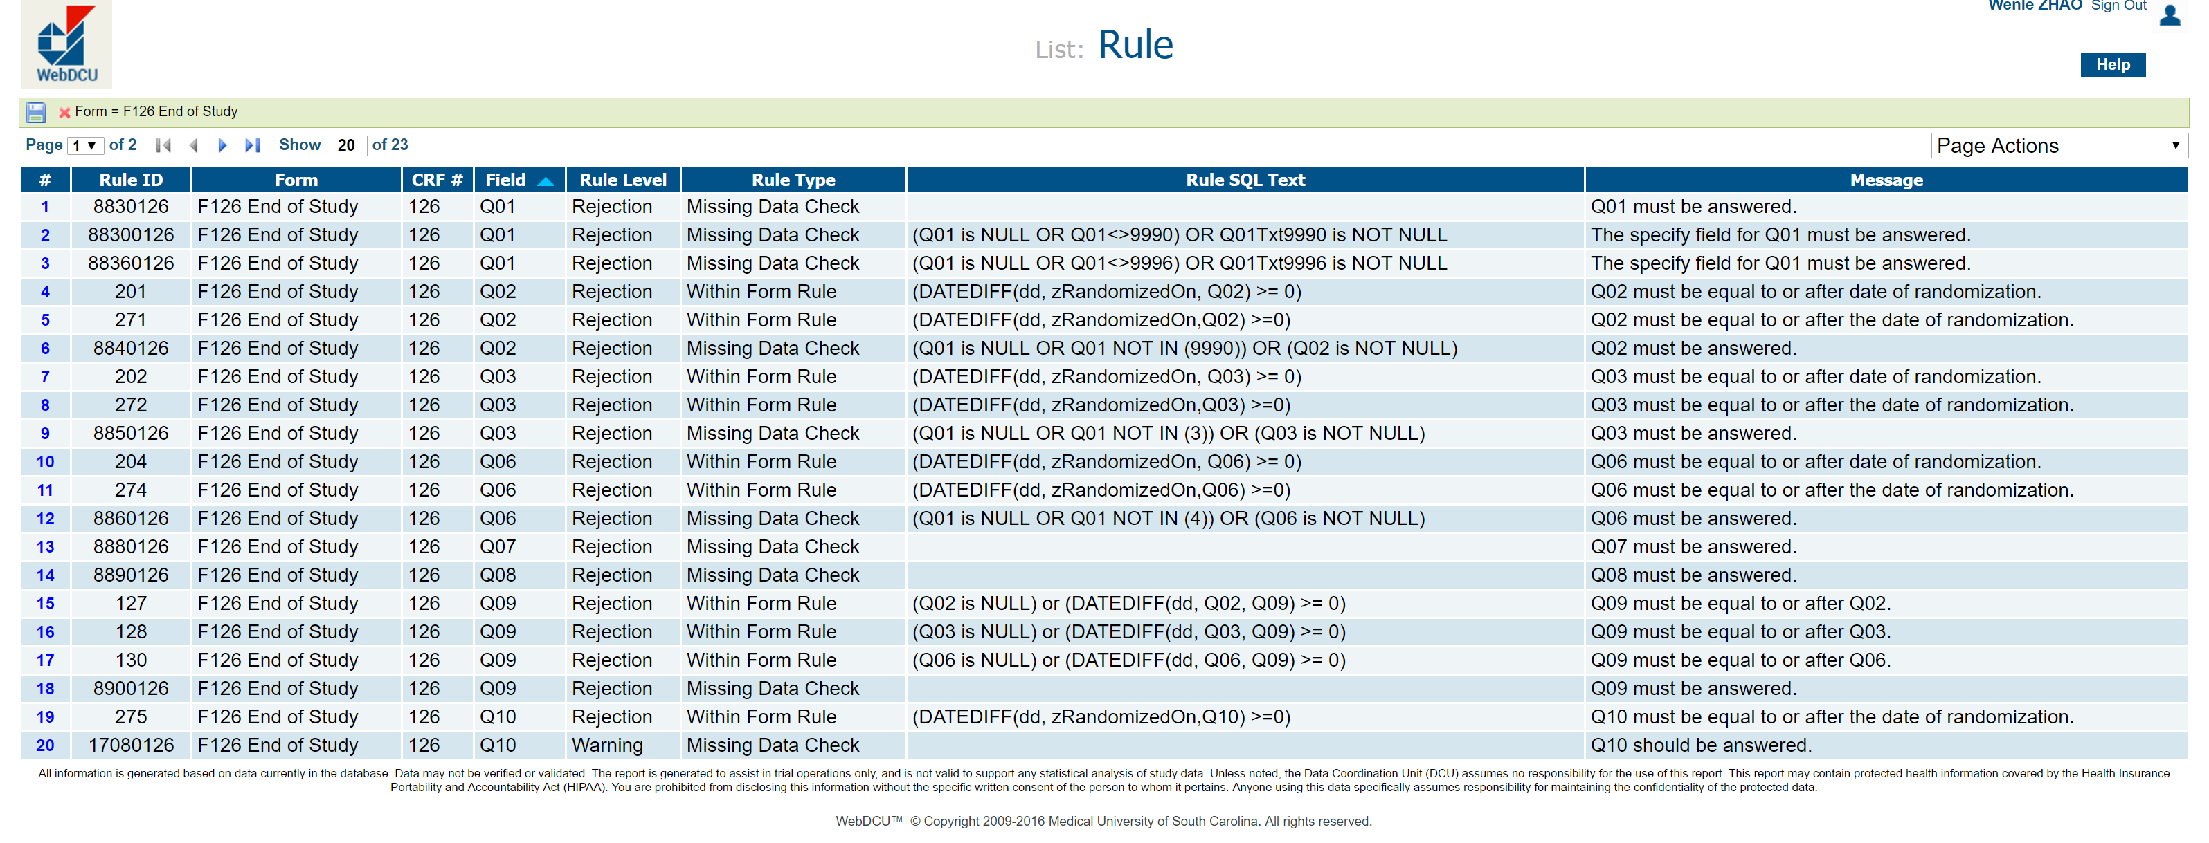
Example 13: Define data validation rules
    Real-time alert for users to prevent data entry typo errors.
    For this example, the End of Study CRF has 23 data validation rules, checking missing data, data value range, and date/time sequences.

Slide 39
Levels of data validation rules
    Reject record saving: prevent basic logic violations.
      data type mismatch
      missing index field data
    Reject CRF submission: prevent data logic conflict, and ensure CRF completion.
      Checked “Other”, without “Other specify”
      Incorrect date/time sequence
    Protocol violation: entered value indicates protocol violation. Allow CRF submission after confirmation of protocol violation.
      Eligibility criteria violation.
      Study treatment (dose, timing, duration, etc.)
    A data validation rule may include multiple data items on the same CRF or across different CRFs.

Slide 40
Use validated assessments
  Hamilton Rating Scale for Depression (HRS-D)
  NIH Stroke Scale (NIHSS)
  The Short Form (36) Health Survey (SF-36)
  Modified Rankin Scale (mRS)
  Clinical Global Impression (CGI)
  Glasgow Outcome Scale (GOS)
  Montgomery-Asberg Depression Rating Scale (MADRS)
  Quality of Life in Neurological Disorders (Neuro-QOL)
  Pediatric Stroke Outcome Measure Short Neuro Exam (PSOM-SNE)
  King's Outcome Scale for Childhood Head Injury (KOSCHI)
Use validated assessments with version and source information to ensure data validity and intellectual property protection.

Slide 41
Use validated assessments
  When using validated assessments:
    Respect the integrity of the validated assessment. Do not make changes to the question or the answer options.
    When total score is needed, allow users to enter manually calculated total score and include the computer derived total score for cross check.
    For patient completed assessments, use original paper form to collect data and enter data into EDC afterwards. Use of electronic version requires additional validation.

Slide 42

Use of standards
Clinical Data Interchange Standards Consortium (CDISC)
Health Level Seven International (HL7)
NCI Enterprise Vocabulary Services (EVS)
Federal Interagency Traumatic Brain Injury Research (FITBIR)
NINDS Common Data Elements (CDE)

Slide 43
CRF change control
    Changes on CRF may be requested after study start:
      Add or remove CRFs or modify CRF collection schedule.
      Add or remove data items.
      Modify question text.
      Add, modify, or remove response options.
      Add, modify, or remove data validation rules.
    General strategy for CRF changes:
      Do not do it unless absolutely necessary, and benefit > cost.
      Use a new data item for modified questions. Keep the old data item with data in the database.
      When response options change, send collected CRFs back for re-assessment.
Notes:
Mark Taylor 10/21/2016
This isn't always done consistently, so emphasize this point with audience.

Slide 44
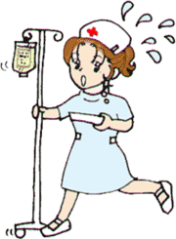
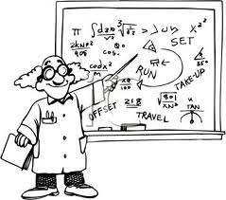

Consider the workload distribution
Employee of the year 2015
Mr. SQL Server
Employee of the year 2016
Mr. SQL Server
Minimize burden for Ms. CDM
Reduce work for Dr. P-value
Maximize work for Mr. SQL Server

Slide 45
Action #3: prevent fake data and data fraud
You can't wake a person who is pretending to be asleep.
    Fake data is created intentionally.
    Fake data destroys the validity of the clinical trial.

Slide 46
Prevention of fake data
    Remove the motivation:
      Data manager’s responsibility is to get true data, good or bad.
      Well designed CRFs prevent forced lying.
      Do not ask the question if the answer is likely not available.
      Do not offer limited options that are not exhaustive.
    Remove the capacity:
      Minimize treatment allocation prediction.
      Maintain treatment blind protection.
      Avoid PI’s micro-management of trial operations.
Notes:
Allow for confrmed missing data

Slide 47
Summary – Section 2
Prevent missing data by better design of study visit transition matrix, data collect schedule, and CRF.
Prevent data errors by better EDC user interface design.
Prevent fake data by removing the motivation and the capacity.
Notes:
Mark Taylor 10/21/2016
This section very much reads like an advance data quality course, be sure to highlight the new or innovative strategies or tactics

Slide 48
3.
Detection of
data quality problems

Slide 49
“Your best teacher is your last mistake.”
― Ralph Nader

Slide 50
Monitor the study progress
    Monitor subject study progress. Ensure compliance with study treatments and assessments specified in the protocol.
    Monitor subject CRF submission timeliness. Ensure data completeness.
    Review CRF rule violation and protocol violation reports.
    Review CRF data that can not be validated by computer rules.

Slide 51
Risk-based monitoring strategy
    Risk-based data monitoring target: data that effects the trial results:
      Eligibility CRF
      Randomization CRF
      Study treatment CRF
      Adverse event CRF
      End of study CRF
      CRFs with primary – secondary efficacy outcomes
      CRFs with confirmed protocol violations

Slide 52
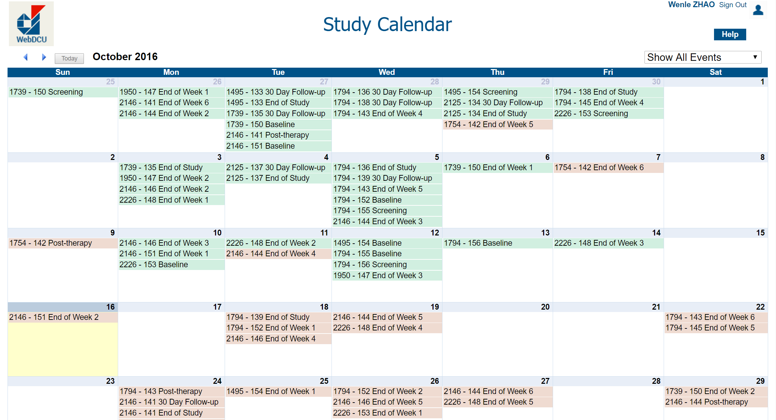
Example 14: Subject study visit monitoring
Take immediate action for overdue study visits.

Slide 53
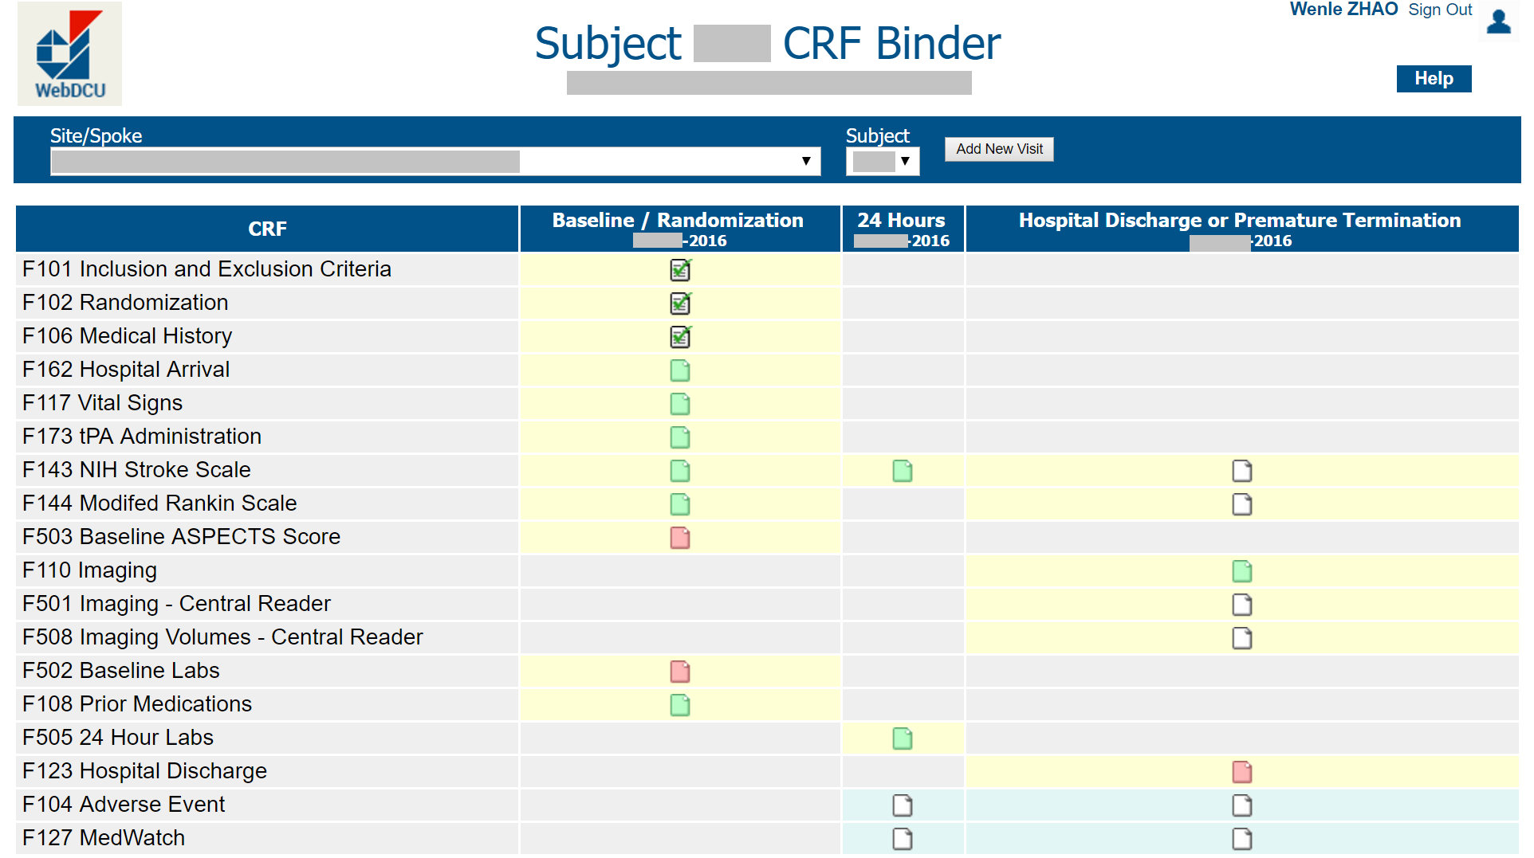
Example 15: CRF completion status monitoring
Contact site study coordinator in cases of delayed CRF submission.

Slide 54
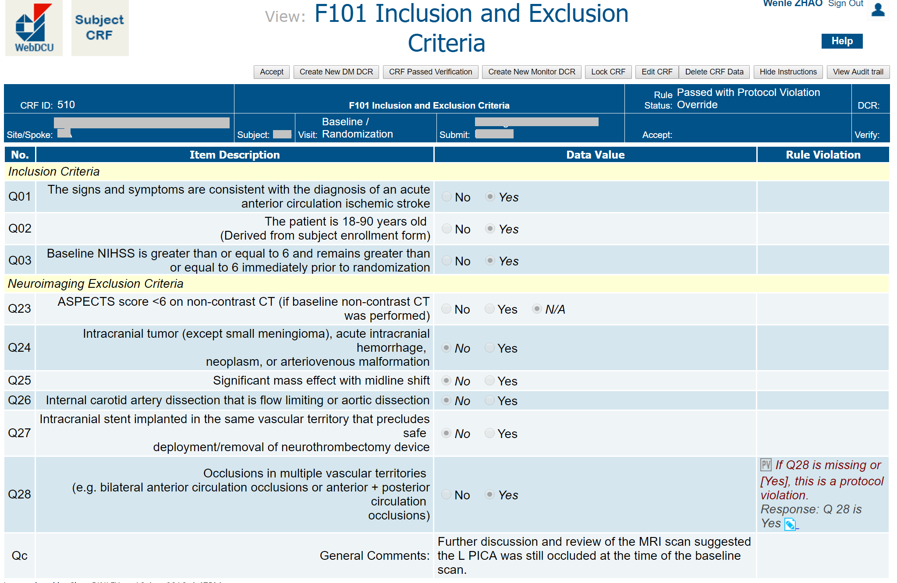
Example 16: Protocol violation review
Contact site for confirmed protocol violation. Request Corrective and Preventive Action Plan (CAPA) when needed.

Slide 55
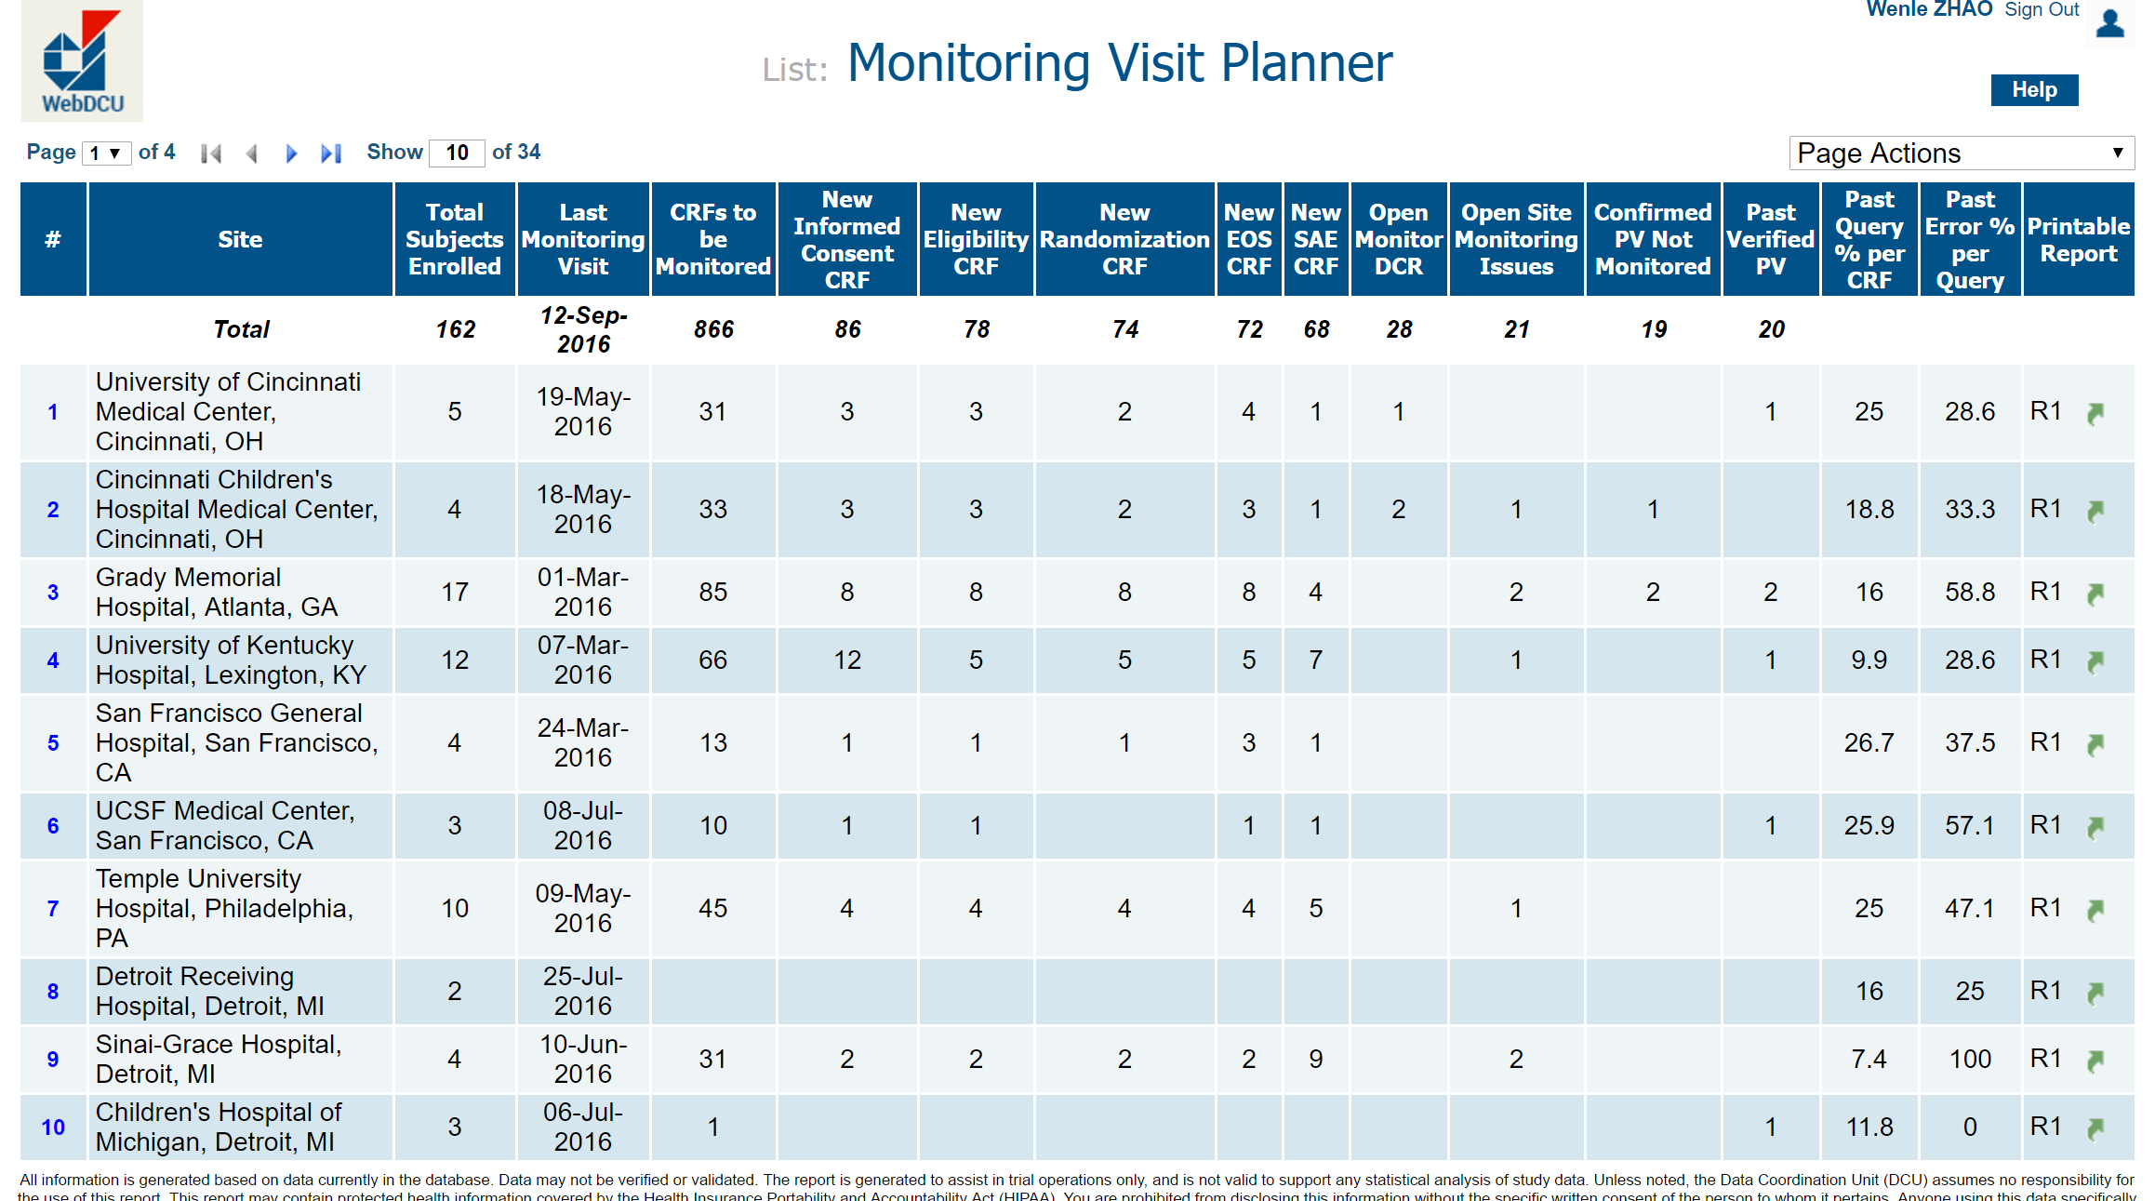
Example 17: Plan on-site monitoring visits
Check number of CRFs for risk-based monitoring.

Slide 56
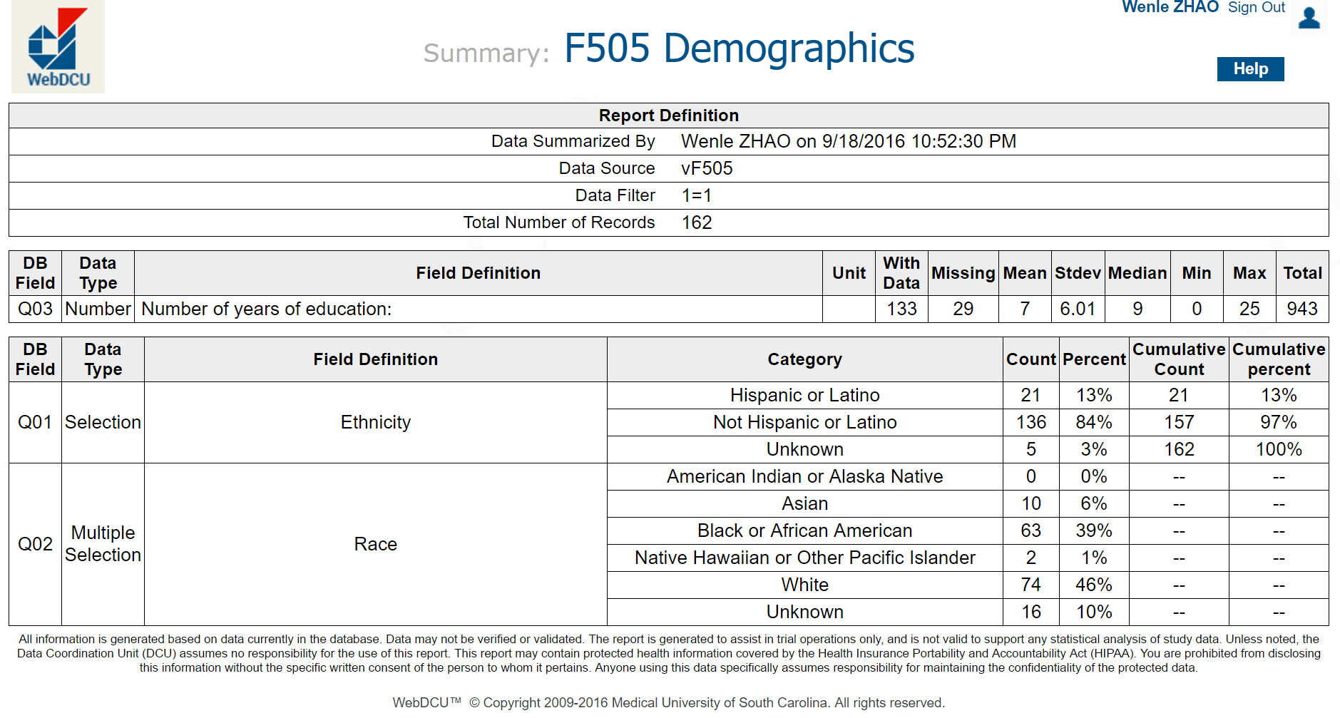
Example 18: Central data quality monitoring
Notes:
Mark Taylor 10/21/2016
Where is the audience supposed to look on this slide, perhaps add a highlight bubble or use laser pointer.
Cnetrally monitor distribution

Slide 57
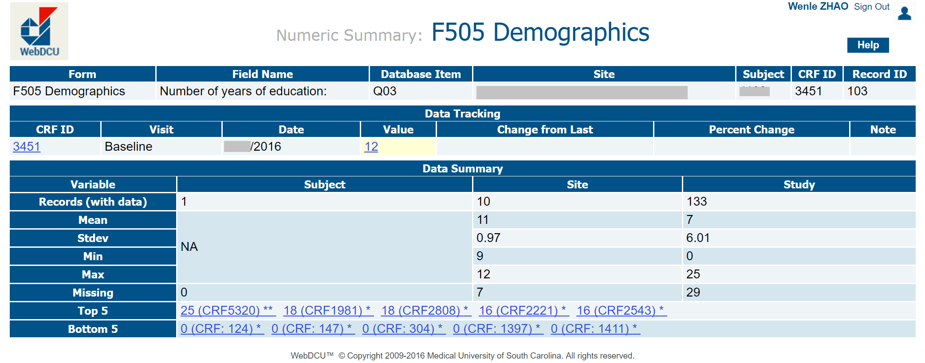
Example 19: Central data quality monitoring
Findings:
  CRF 5320 has number of years of education = 25.
  At least 5 CRFs have number of education years = 0. (may be NA?)

Slide 58
Central data quality monitoring
Data value pattern detection
  1st and 15th day in a month; January and July in a year.
  Rounded to 0 or 5.
Data comparison over time
  Loosened eligibility criteria due to slow enrollment.
  Low site team member retention rate.
  Performance disparity among sites.
  Slow site enrollment ➔ less familiar with study protocol.
  Logic error among data on several CRFs.

Slide 59
Use trial operation performance dashboard
Share data quality report within the study community with information on:
  Enrollment speed and subject retention rate.
  Data completeness.
  CRF submission and data query response timeliness.
  Number of confirmed protocol violations.
  Number of data error detected, but not corrected.

Slide 60
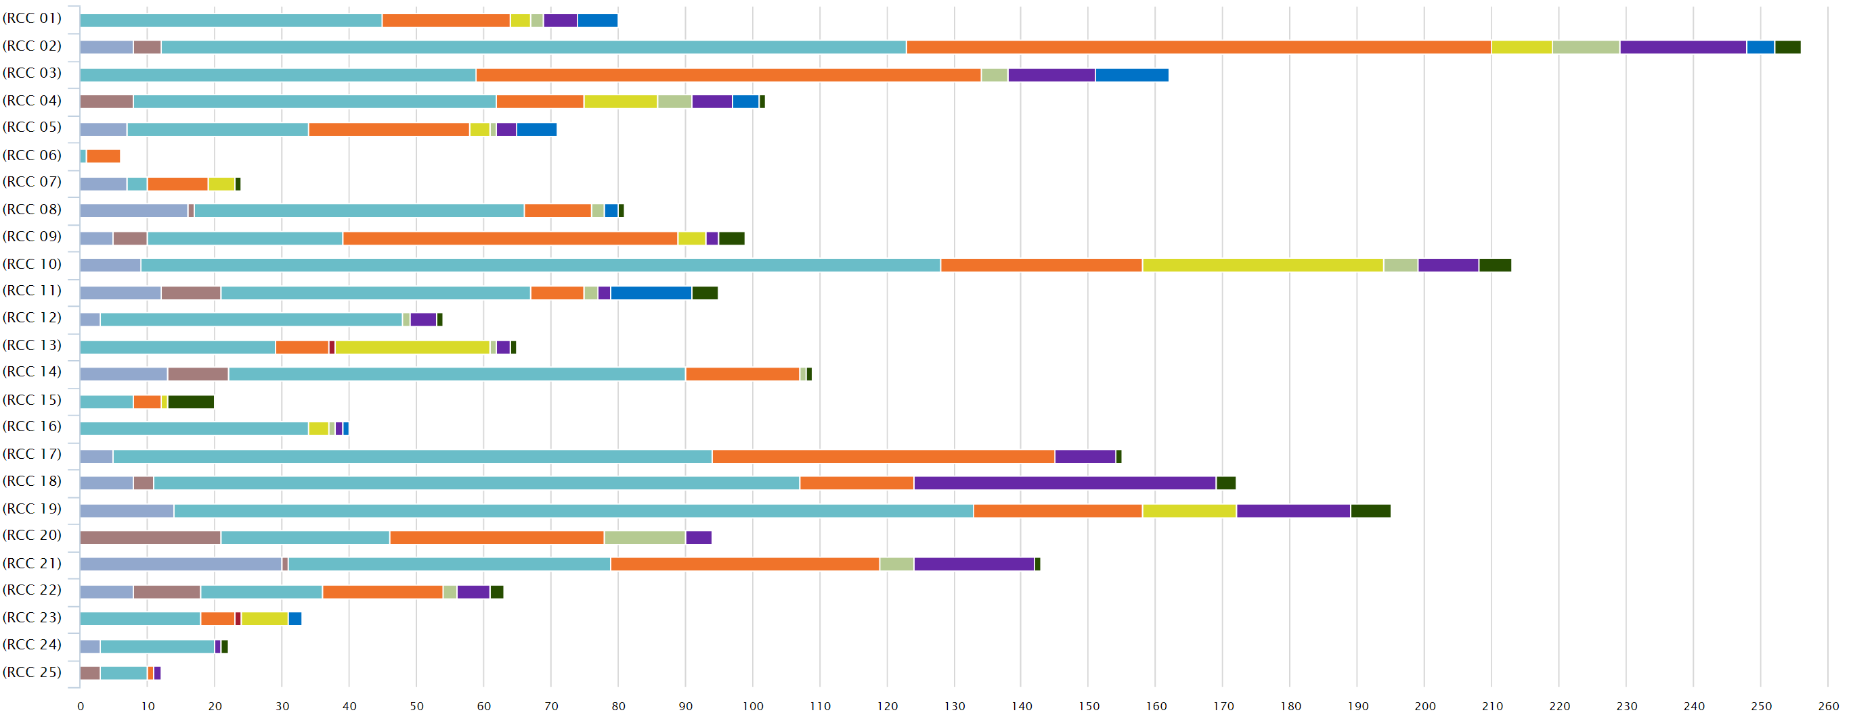
Trial performance dashboard - Enrollment
Notes:
Need tool to do our job. Then we need to do it.
Keep information transparent as long as pt privacy is protected. Give sites feedback and pressure to perform.

Slide 61
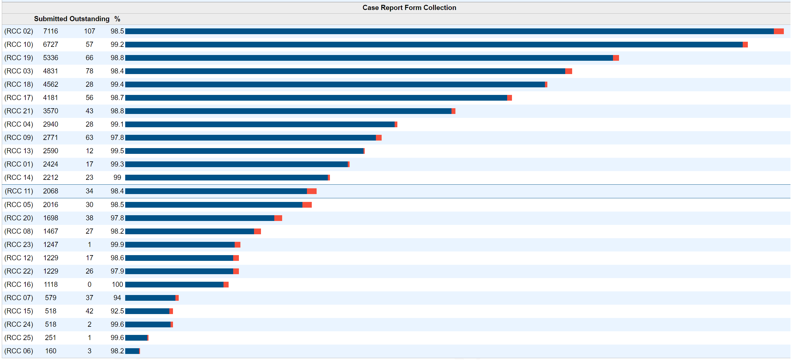
Trial performance dashboard – CRF submit

Slide 62
Summary – Section 3
Data manager data review to detect data error.
Central data monitoring program.
Plan risk-based site monitoring visits when needed.
Share study performance summary data among sites.

Slide 63








Use a proper tool for the job
White House
to
Capital Hill
New York
to
Boston
Houston
to
San Francisco
Retrospective registry
Small early phase trial
Multicenter Phase 3 RCT

Slide 64
Thank You!
Contact:
Catherine Dillon
rileycp@musc.edu

