Slide 1
Speaking Clinical Trials
Marianne Kearney
Director of Research Operations Neurological Clinical Research Institute
Massachusetts General Hospital

Slide 2
Goals of successful collaboration in multicenter clinical trials
Efficient implementation of the trial across multiple clinical sites
Recruitment and subject retention on target with projections
Minimal drop-outs/missing data points
Achieve a definitive answer to the hypotheses proposed using good science and good analyses plans

Slide 3
How can we achieve these goals?
Clear understanding of tasks and issues
Clear understanding of timelines and study budget
Coordination of efforts
Ensure the study team is effectively communicating!

Slide 4
Communication
Oxford dictionary: “The imparting or exchanging of information or news”
Wikipedia: “The activity of conveying information through the exchange of ideas, feelings, intentions…”; “The communication process is complete once the receiver understands the senders message”

Slide 5
Communication
“The single biggest problem in communication is the illusion that it has taken place.”
-- George Bernard Shaw

Slide 6
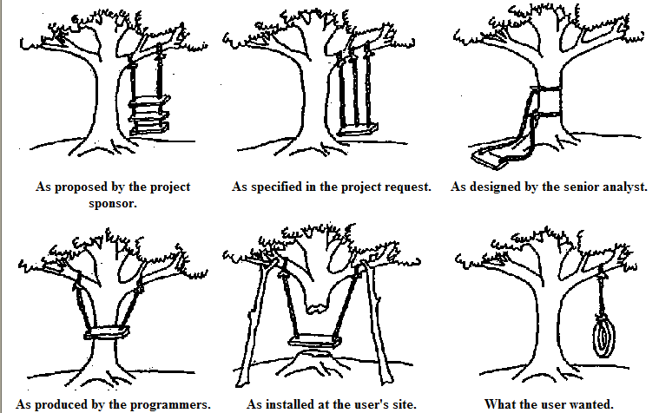
How can we avoid this?

Slide 7
Effective Communication….

Slide 8
Question #1
Which best describes effective communication?
(A) Both parties agree
(B) The receiver understands the senders message
(C) The sender believes the receiver understands the message
(D) Both parties disagree

Slide 9
Effective Communication
Know your audience/collaborators and understand their perspective
Speak a common language
Translate as needed!

Slide 10
Collaborators have different roles

Slide 11
PI & Lead Coordinator/ PM
Develop the initial questions or hypothesis of trial
Focus is on answering a clinical question

Slide 12
Clinical Sites
Interested in providing their patients with access to clinical trials

Slide 13
Coordinating Center
Operational aspects of study
Various members:
IT/ data managers
Project managers
Biostatisticians
Study monitors
Regulatory
Vendors/contractors

Slide 14
IRB
Focus on protecting research subjects and ensuring research is conducted ethically

Slide 15
DSMB
Monitor study data and safety events, to ensure integrity of data and subject safety

Slide 16
Financial sponsor
Primary focus on funding studies that have sound scientific justification and will have impact on the field of study / disease

Slide 17
FDA
Public safety

Slide 18
Patient Representatives
Provide valuable feedback on study feasibility and relevance of the study question/endpoint to patients with this disease

Slide 19
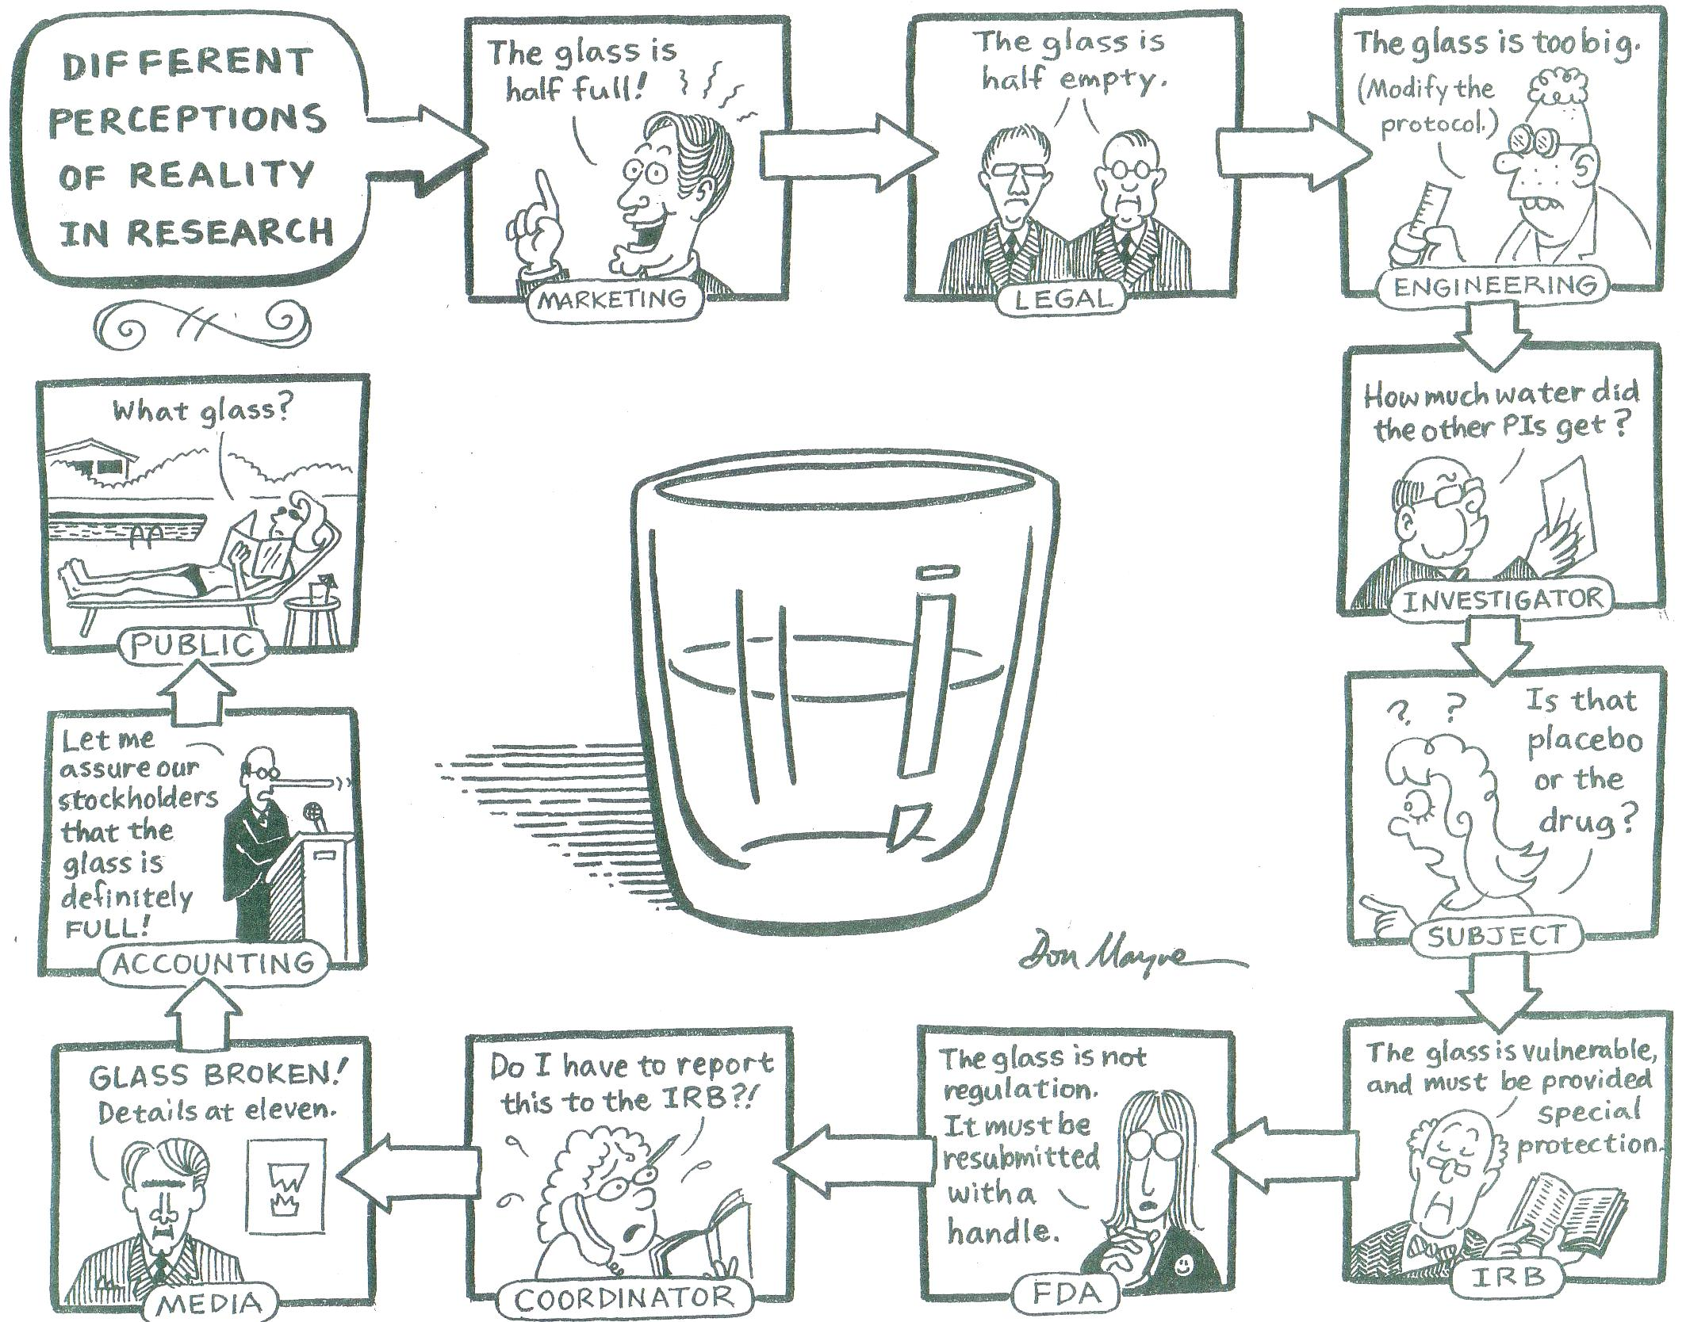
It’s all in your perspective!

Slide 20
Question #2
The primary focus of Financial Sponsor’s is:
(A) Protecting research subjects
(B) Operational aspects of trial
(C) Funding studies that have sound scientific justification
(D) Public safety

Slide 21
Speaking a Common Language!
“Clinical”
SAS
Common data elements
Regulatory/IRB
Legalese
Pharma
Patients

Slide 22
Acronyms and Jargon…
PI
42 yo WF
FDA
Stopping Rules
SAE
IRB
NIH
NOGA
CFR or CRF?
DCC
TEAE
SAS
LOL?
IND

Slide 23
Application vs. Application!
Computer: software designed to fill specific needs of a user
Regulatory: application made to a health authority to market or license a new product

Slide 24
CRF vs. CFR!
Case Report Form
A record of clinical study observations that a study protocol designates must be completed for each subject
Code of Federal Regulations
Codification of general and permanent rules and regulations published in the Federal Register

Slide 25
DSMB
Data and Safety Monitoring Board
Independent group of experts who monitor patient safety and treatment efficacy data while a trial is ongoing

Slide 26
GCP
Good Clinical Practice
A standard for the design, conduct, performance, monitoring, auditing, recording, analyses and reporting of clinical trials

Slide 27
IRB
Institutional Review Board
Independent body of medical, scientific and non-scientific members, whose responsibility it is to ensure the protection of the rights, safety and well-being of human subjects involved in a trial

Slide 28
IMM / MSM
Independent Medical Monitor
NINDS study that does not require oversight by a DSMB will appoint an IMM
Medical Safety Monitor
NINDS funded Multicenter studies requiring a DSMB will also appoint a MSM
Physician, not involved in the study, responsible for ongoing monitoring of reports of Serious Adverse Events in real time and Adverse Events on a periodic basis, but remains blinded to study treatment

Slide 29
Screening
Substance: Process by which substances are evaluated in a battery of tests or assays
Potential patient: Active consideration of potential subjects for enrollment in a trial
Screen failures are potential subjects who do not meet one or more of the inclusion criteria required to be eligible

Slide 30
SOA
Schedule of Assessments
Study specific visit schedule typically in table format
Useful in preparing your study budget, to determine the cost of each procedure that will be performed on each subject

Slide 31
Question #3
The acronym IRB refers to:
(A) Investigational Requirement Board
(B) Institutional Review Board
(C) Informed Research Board
(D) Information Review Board

Slide 32
Translation….
Translation….

Slide 33
Clinicians and Biostatisticians
Strength of the pre-clinical data to support the hypothesis
What data can support the sample size calculation?
When is a subject “enrolled”?
Time of consent, or
Time of randomization, or
Time of drug/placebo treatment
What is the anticipated screen failure rate?
How many patients will be consented, then be determined not to meet eligibility criteria?

Slide 34
Clinicians and Biostatisticians
What is the duration of the study?
How long will it take to recruit all subjects?
How long will each subject be on study drug/placebo
How long will they be followed after stopping study drug/placebo?
What will we do with all this data?
Primary endpoint
Secondary endpoints
Safety endpoints
Exploratory endpoints

Slide 35
PI and IT/Data Managers
Requires clear understanding of the protocol, patient population and expected data points to be collected
Clearly written specifications for the data capture system
Develop use-friendly, intuitive data capture system
Rigorous testing and validation of the data capture system

Slide 36
PI and Financial Sponsor
Recruitment / retention
Screen failure rate
Data quality
Unanticipated costs
Competing trials

Slide 37
Coordinating Center and Clinical Sites
Coordinating Center focus on ensuring all data is collected per protocol
Site personnel are focus on patient care
Communicate about protocol questions, adverse events, unanticipated problems

Slide 38
IRB and Clinical Sites
Provide well-written Informed Consent Form templates in lay language
Provide reports on study activity and safety to the IRB as requested (expedited and at time of continuing review)

Slide 39
Next steps
Challenges and Strategies for Success

Slide 40
How to communicate
Email
Voicemail
Conference calls/ webinars
In person meetings
Discuss preferences and expectation of responsiveness

Slide 41
Who talks with whom
Flow of communication should be clearly outlined at the beginning of a trial
Include project manager or lead study coordinator on all communication, so you have a record of decisions and future action items

Slide 42
Strategies for Study Start Up
Conduct “kick off” meeting with all study team members
Host routine meetings involving the entire study team
Ensure everyone has base understanding of the research goals, timeline and budget

Slide 43
Strategies for Meetings
Distribute agenda 1 – 2 days prior to meeting
Start meeting with review of action items from prior meeting
Involve all team members and encourage questions/discussion
Review timeline and upcoming milestones
Meeting minutes should capture key decisions and action items
Minutes should be distributed to all team members within 2 – 3 business days

Slide 44
Once your trial has started
Staffing on projects change over the course of a trial. Good documentation will help transition from one staff member to another
Maintain routine meeting schedule to ensure team members remain clear about goals, timeline and budget constraints

Slide 45
Analysis, publication & closeout
Timeline for database “lock”
Data sharing issues
What governs how data can be shared?
Contracts
IRB
Be sure sites have clear timeline for completion of data entry and query resolution

Slide 46
Conclusion
Effective communication is essential for successful coordination of multicenter clinical trials
Key players/collaborators have different perspectives and priorities
Funding often drives decisions

Slide 47
Key to Success is….

Slide 48
Thank you for your attention!

