Slide 1
Partnering with Industry
NINDS Clinical Trials Methodology Course
Jeffrey L. Saver, MD
Professor and SA Vice-Chair for Clinical Research
Department of Neurology
David Geffen School of Medicine at UCLA

Slide 2
JLS Disclosures
Employee of the University of California. The University of California has patent rights in retrieval devices for stroke.
Unpaid site investigator in multicenter trials run by Medtronic, Stryker and Neuravia/Cerenovus, for which the UC Regents received payments on the basis of clinical trial contracts for the number of subjects enrolled.
Receives compensation for services as a scientific consultant regarding rigorous trial design and conduct to Medtronic, Stryker, Cerenovus, Rapid Medical, Diffusion Pharma, BrainsGate, Boehringer Ingelheim (prevention only), and St. Jude Medical.
Serves as an unpaid consultant to Genentech advising on the design and conduct of the PRISMS trial; neither the University of California nor Dr. Saver received any payments for this voluntary service.

Slide 3
The Neurotherapeutic Age
Neurology now an emphatically and powerfully therapeutic discipline
1988 – “Diagnose and adios”
2017 – “Greet and treat”
Due to RCTs
Therapies available for
7 of the 8 leading neurologic diseases
91% of the worldwide neurologic burden of disease
Global Neurologic Burden of Disease (DALYs) - Top 8 Causes
Stroke
Migraine/Headaches
Epilepsy
Alzheimer and other Dementias
Meningoencephalitis
Parkinson Dz
TBI
Multiple Sclerosis
--Modified from Chin JH et al, Neurology 2014

Slide 4
Acute Ischemic Stroke Care 1990 Therapies with Positive Trials and Practice Adoption

Slide 5
Acute Ischemic Stroke Care 1990 - 2018 Therapies with Positive Trials and Practice Adoption
Treatment | Year
IV Fibrinolysis < 3h | 1995
Stroke Unit Care | 1997
PO Aspirin < 48h | 1997
IA Fibrinolysis < 6h | 1999
IV Fibrinolysis 3-4.5h | 2008
PO Double Antiplatelet Therapy < 48h | 2013/2018
Mech Thrombectomy < 6h | 2015
Mech Thrombectomy, imaging 6-24h | 2018
IV Fibrinolysis, w/ Imaging > 4.5h | 2018

Slide 6
Acute Ischemic Stroke Care 1990 - 2018 Therapies with Positive Trials and Practice Adoption
Treatment | Year | Industry Contribution
IV Fibrinolysis < 3h | 1995 | 10%
Stroke Unit Care | 1997 | 0%
PO Aspirin < 48h | 1997 | 0%
IA Fibrinolysis < 6h | 1999 | 90%
IV Fibrinolysis 3-4.5h | 2008 | 90%
PO Double Antiplatelet Therapy < 48h | 2013/2018 | 10%
Mech Thrombectomy < 6h | 2015 | 90%
Mech Thrombectomy, imaging 6-24h | 2018 | 50%
IV Fibrinolysis, w/ Imaging > 4.5h | 2018 | 33%

Slide 7
Increasing Proportion of Clinical Trials Industry-Sponsored
“Interventional studies” registered in clinicaltrials.gov 2006-14
Industry-funded trials ↑43%
NIH-funded trials ↓24%
Final year-86% of industry/NIH trials industry-funded
-Ehrhardt et al. JAMA 2015

Slide 8
Perspectives on Industry Clinical Trials
“Drugs are tested by the people who manufacture them, in poorly designed trials, on hopelessly small numbers of weird, unrepresentative patients, and analysed using techniques which are flawed by design, in such a way that they exaggerate the benefits of treatments.”
-Ben Goldacre, Bad Pharma: How Drug Companies Mislead Doctors and Harm Patients

Slide 9
Perspectives on Industry Clinical Trials
“Drugs are tested by the people who manufacture them, in poorly designed trials, on hopelessly small numbers of weird, unrepresentative patients, and analysed using techniques which are flawed by design, in such a way that they exaggerate the benefits of treatments.”
-Ben Goldacre, Bad Pharma: How Drug Companies Mislead Doctors and Harm Patients
“Due to progress in biopharmaceutical researchers’ understanding and use of genetic sequencing, real-world data and computational science, America’s biopharmaceutical companies are now, more than ever before, prepared to respond to the tremendous unmet medical needs experienced by patients throughout the United States.”
-Innovation.org (America’s Biopharmaceutical Companies)

Slide 10
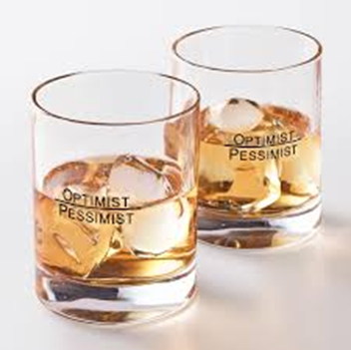
Perspectives on Industry Clinical Trials
“Drugs are tested by the people who manufacture them, in poorly designed trials, on hopelessly small numbers of weird, unrepresentative patients, and analysed using techniques which are flawed by design, in such a way that they exaggerate the benefits of treatments.”
-Ben Goldacre, Bad Pharma: How Drug Companies Mislead Doctors and Harm Patients
“Due to progress in biopharmaceutical researchers’ understanding and use of genetic sequencing, real-world data and computational science, America’s biopharmaceutical companies are now, more than ever before, prepared to respond to the tremendous unmet medical needs experienced by patients throughout the United States.”
-Innovation.org (America’s Biopharmaceutical Companies)

Slide 11
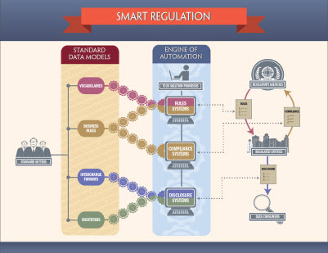
Perspectives on Industry Clinical Trials
“Drugs are tested by the people who manufacture them, in poorly designed trials, on hopelessly small numbers of weird, unrepresentative patients, and analysed using techniques which are flawed by design, in such a way that they exaggerate the benefits of treatments.”
-Ben Goldacre, Bad Pharma: How Drug Companies Mislead Doctors and Harm Patients
“Due to progress in biopharmaceutical researchers’ understanding and use of genetic sequencing, real-world data and computational science, America’s biopharmaceutical companies are now, more than ever before, prepared to respond to the tremendous unmet medical needs experienced by patients throughout the United States.”
-Innovation.org (America’s Biopharmaceutical Companies)

Slide 12
Problem | Regulatory Mitigation
Undeclared investigator financial COI | -Journals – required reporting; -US govt – Physician payments sunshine act -AMCs manage faculty COI
Non-publication of negative trials | -FDA/Journals: Trial registration; required results reporting -AMCs: contracts retain publication rights
Reporting only favorable endpoints; p-hacking | -FDA/Journals: Primary endpoint specification pre-launch in trial registration
Guest authorship | -Journals: required identification of all contributors; some require 1st draft by academic authors
Data sequestration | -FDA/EMA data transparency programs -Journals data sharing statements

Slide 13
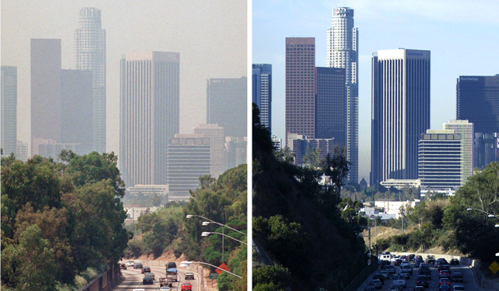
1990s
2016
Problem | Regulatory Mitigation
Undeclared investigator financial COI | -Journals – required reporting; -US govt – Physician payments sunshine act -AMCs manage faculty COI
Non-publication of negative trials | -FDA/Journals: Trial registration; required results reporting -AMCs: contracts retain publication rights
Reporting only favorable endpoints; p-hacking | -FDA/Journals: Primary endpoint specification pre-launch in trial registration
Ghost authorship | -Journals: required identification of all contributors; some require 1st draft by academic authors
Data sequestration | -FDA/EMA data transparency programs -Journals data sharing statements

Slide 14
Drug Discovery and Development
-Pharmaceutical Research and Manufacturers of America. Drug discovery and development: understanding the R&D process. www.Inovation.org

Slide 15
Natural Roles of Academia and Industry
-Flier J. Academia and industry: allocating credit for discovery and development of new therapies. J Clin Invest 2019

Slide 16
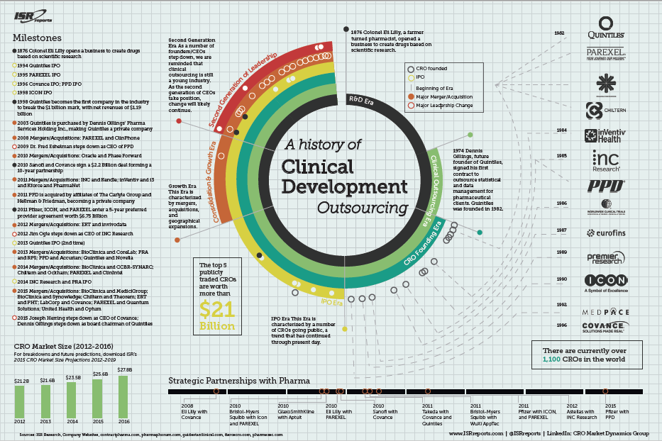

Slide 17
Disclosure of clinical trial results by industry vs non-industry sponsors
-Baronikova S et al. BMJ Evidence-Based Medicine 2018

Slide 18
Compliance with requirement to report results on EU Clinical Trials Register
7274 clinical trials more than 1 year post-completion as of Dec 2016
Overall, 49.5% reported results on register
Sponsor type | Reporting frequency | OR (95% CI)
Industry vs non-industry | 68.1% vs 11.0% | 23.2 (19.2-28.2)
Sponsor of many vs few trials | 77.9% vs 18.4% | 18.4 (15.3-22.1)
-Goldacre B et al. BMJ 2018;362:k3218

Slide 19
Association of Funding Source with Effect Size in RCTs
509 RCTs in JAMA, NEJM, Lancet 2013-2015
Difference associated mainly with use of surrogate endpoints in industry trials
Sponsor type | Reporting frequency | OR (95% CI)
Industry | 1.92 | 1.72-2.14
Mixed | 1.34 | 1.25-1.43
Non-industry | 1.32 | 1.26-1.39
-Falk Delgado A et al. Trials 2017

Slide 20
Association of Industry Collaboration with Quality and Outcome of Oncology RCTs
224 RCTs, journals with IF > 5, 2013-2015
No industry funding (31%) vs funding-only (18%) vs industry collaboration (50%)
-Linker et al. Eur J Cancer 2017

Slide 21
Association of Industry Collaboration with Quality and Outcome of Oncology RCTs
224 RCTs, journals with IF > 5, 2013-2015
No industry funding (31%) vs funding-only (18%) vs industry collaboration (50%)
Industry collaboration associated with
Higher quality features
-Linker et al. Eur J Cancer 2017

Slide 22
Association of Industry Collaboration with Quality and Outcome of Oncology RCTs
224 RCTs, journals with IF > 5, 2013-2015
No industry funding (31%) vs funding-only (18%) vs industry collaboration (50%)
Industry collaboration associated with
Higher quality features
Same rate of positive outcomes
-Linker et al. Eur J Cancer 2017

Slide 23
Trial Quality and Publication Bias in Acute Stroke Trial Reporting
178 acute ischemic stroke trials, 1955-1999
75 agents/interventions
Trial report quality
Industry vs non-industry supported: 69.2 vs 53.4, p<0.005
Lag in reporting neutral/harmful vs positive results
Industry trials: 2.8 vs 2.1 years, p=0.09
-Liebeskind D et al. Neurology 2006;67:973–979

Slide 24
Guest Authorship of High-Impact RCTs
169 RCTs, journals with IF > 11, 2011-2012
No industry funding or collab (23%) vs industry funding w/o collab (45%) vs industry funding w/ collab (32%)
Guest authorship definition
Neither of first/last author contributed to: 1) trial design or data analysis, or 2) first draft of paper
Industry funding with collaboration associated with guest authorship
-Roper et al. J Gen Intern Med 2015

Slide 25
Academic Roles in Industry Clinical Trials
Site Investigator
Steering Committee
Principal Investigator
DSMB
Clinical Events Committee
Publication Committee Member
Secondary Manuscript Author

Slide 26
Range of Approaches to Governance of Academic-Industry Collaborative RCTs
Completely (nearly) academic directed
Funding and agent supplied by industry
Example - TIMI group trials
Funding by NIH/NGO, agent by industry
Example – NINDS tPA trials
Shared oversight
Steering Committee with both academic and industry members
Academic Steering Committee advisory rather than final authority
Completely (nearly) industry directed
No independent academic Steering Committee

Slide 27
Domain Roles of Academic Authors, Sponsors, and CROs in Recent RCTs Analysis of 200 trials 2014-17
-Rasmussen et al. BMJ 2018;363:k3654

Slide 28
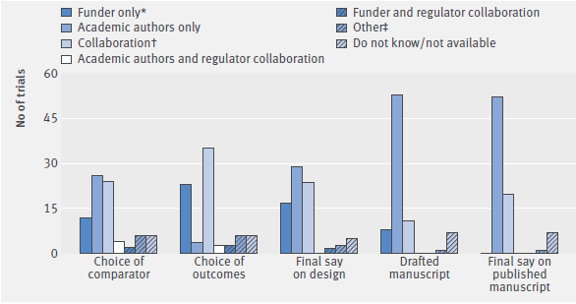
Specific Decisions by Academic Authors, Sponsors, and CROs in Recent RCTs Analysis of 200 trials 2014-17
-Rasmussen et al. BMJ 2018;363:k3654

Slide 29
Typical Interventions Studied in Industry vs Non-Industry Trials
Industry
Non-Industry
New, proprietary drugs
New, proprietary devices
First-in-class agents
Later-in-class (“me-too”) agents vs control
Orphan disease when high payoff
Older, off-patent drugs
Older, off-patent devices
First-in-class agents
Later-in-class agents against each other (head-to-head)
Surgical interventions not using new devices
Systems of care
Orphan disease when low payoff

Slide 30
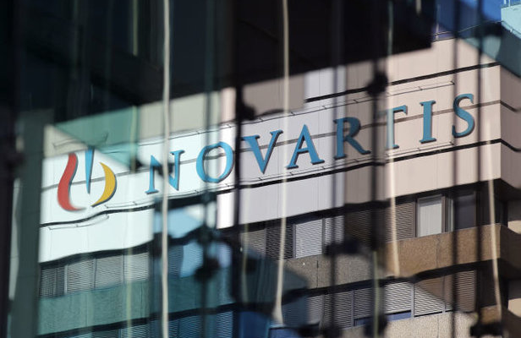
Industry Responds to Financial Incentives
Spinal muscle atrophy
360 new cases in US annually
Zolgensma (onasemnogene abeparvovac-xioi)
Survival motor neuron (SMN) gene + viral vector
Approved by FDA May 2019
Price per patient: $2.1 million

Slide 31
-Ehrismann + Patel. University – Industry collaborations: models, drivers and cultures. Swiss Med Weekly 2015

Slide 32
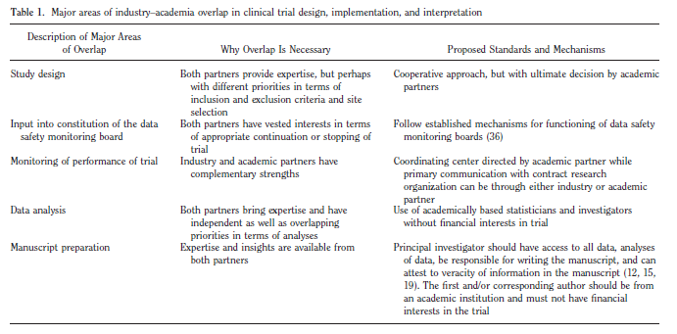
-Abraham E. Better infrastructure: Industry–academia partnerships—A marriage of convenience? Crit Care Med 2009

Slide 33
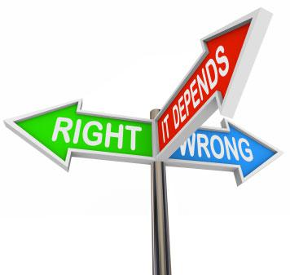
War stories
Primary results platform last minute suppression
Eloquent non-presentation
Company breaks lock and immediately declares bankruptcy
Data rescue by academic investigators
Small device company breaks blind early in trial
Admonition
Drug company increases agent price in clinical practice
Good cop – bad cop Steering Committee split
Drug company stops trial early due to slow enrollment
Steering committee formally votes against stoppage
Device company wishes to add subgroup as additional primary shortly before trial completion
Steering committee counsels against; subgroup saves trial

Slide 34
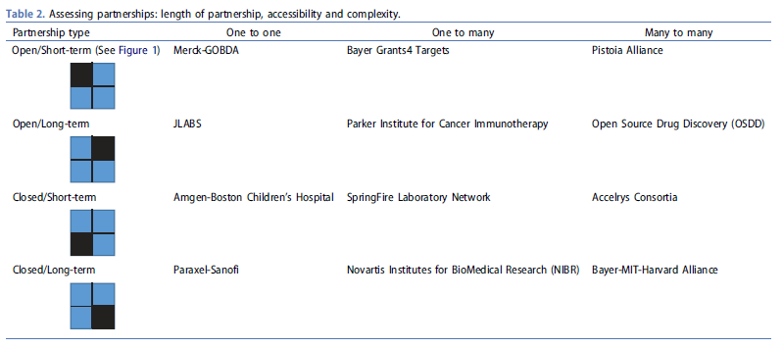
New Academic – Industry Collaboration/Partnership Models -Openness, duration, size
-Allarhakia M. Evolving models of collaborative drug discovery: managing intellectual capital assets. Exp Opin Drug Discov 2018

Slide 35
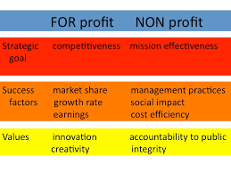
Aiming for The Best of Both Worlds

Slide 36
